Slide 1
Towards a Quadratic Time Approximation of Graph Edit Distance
Fischer, A., Suen, C., Frinken, V., Riesen, K., Bunke, H.
Contents
Introduction
Graph edit distance
Hausdorff distance
Approximating the ged with Hausdorff distance
Application, experimental evaluation and results
Conclusions
Fischer, A., Suen, C., Frinken, V., Riesen, K., Bunke, H.: A fast matching algorithm for graph-based handwriting recognition, submitted

Slide 2
Introduction
Graph edit distance is a well established concept to measure the dissimilarity of graphs
It can be used for nearest-neighbor classification, clustering, and various kernel methods based on dissimilaritiy
However in its original form, ist complexity is exponential
Therefore, various approximate procedures have been proposed for ist computation; for a recent review see
X. Gao, B. Xiao, D. Tao, X. Li: A survey of graph edit distance, Pattern Analysis & Applications 13, 113-119, 2010
In this presentation we describe work towards a new approximate procedure, based on Hausdorf distance, that runs in quadratic time

Slide 3
Graph Edit Distance
Measures the distance (dissimilarity) of given graphs g₁ and g₂
Is based in the idea of editing g₁ into g₂
Common edit operations are deletion, insertion and substitution of nodes and edges
Can be used with a cost function

Slide 4
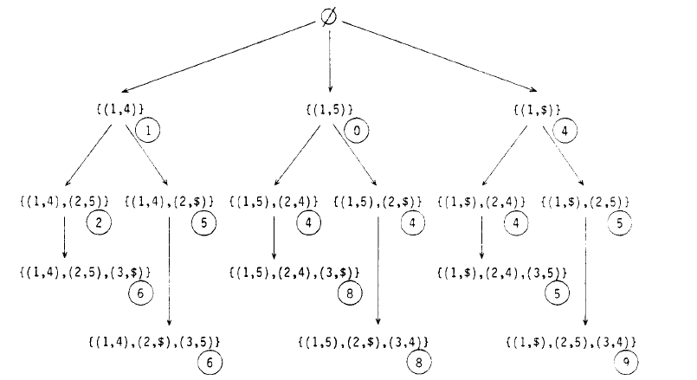
Computational Procedure
Bunke, H., Allermann, G.: Inexact graph matching for structural pattern recognition, PRL 1, 245 – 253, 1983

Slide 5
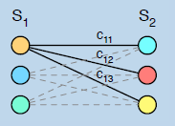
Approximating the GED by an Assigment Procedure
Given are two sets, X={x₁,…,x_{n}} and Y={y₁,…,y_{n}} together with a cost function c_{ij}.
We want to find a one-to-one mapping that minimizes the cost Σc_{if(i)}
Problem was originally studied in the context of Operations Research (assignment of workers to jobs)
Many algorithms exist, typically with O(n³) complexity (Hungarian, Munkres, Volgenant/Jonker,…)

Slide 6
The assignment problem has nothing to do with the ged problem
However, ged can be reformulated (simplified), such that it can be approximately solved with an assignment procedure
Different reformulations are possible (only nodes, nodes plus edges)
The procedures that solve the assignment problem are optimal
They are only suboptimal w.r.t. ged problem, but they run in cubic time and give good approximations of the true distance
K. Riesen and H. Bunke. Approximate graph edit distance computation by means
of bipartite graph matching. Image and Vision Computing, 27(7):950–959, 2009

Slide 7
Hausdorff Distance (1)
A well-known distance measure between sets of points in a metric space
Often used in image processing as a distance between sets of points in the 2-D plane, or in 3-D space; see, for example,
Huttenlocher, D.P., Klanderman, G.A., Rucklidge, W.J.: Comparing images using the Hausdorff distance, PAMI 15, 850–863, 1993

Slide 8
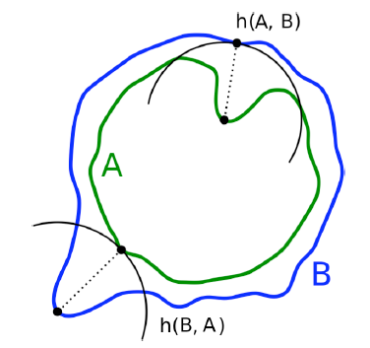
Given sets A and B, and a distance metric d(a,b)
H(A,B)=max(max_{a∊A}min_{b∊B} d(a,b),max_{b∊B} min_{a∊A} d(a,b))
Computational complexity is O(nm), where |A|=n and |B|=m

Slide 9
Hausdorff Distance (2)
Because of the max-operator, H-distance is sensitive to outliers in the data
There are various possibilities to overcome this problem: delete top-n, average, median,…
In the following: replace max-operator by summation (equivalent to averaging)
H’(A,B) = Σ_{a∊A}min_{b∊B} d(a,b) + Σ_{b∊B} min_{a∊A} d(a,b)

Slide 10
Hausdorff Distance (2)
Because of the max-operator, H-distance is sensitive to outliers in the data
There are various possibilities to overcome this problem: delete top-n, average, median,…
In the following: replace max-operator by summation (equivalent to averaging)
H’(A,B) = Σ_{a∊A}min_{b∊B} d(a,b) + Σ_{b∊B} min_{a∊A} d(a,b)

Slide 11
Approximating Graph Edit Distance with H-Distance
Sets A and B correspond to the sets of nodes of graphs g₁ and g₂
Distance d(a,b) between a∊A and b∊B is given by node substitution cost
In the present case, it is the Euclidean distance of the node attribute vectors (x,y)_{u} and (x,y)_{v} of nodes u∊g₁ and v∊g₂:
c(u,v)= ∥(x,y)_{u}- (x,y)_{v}∥
Result:
h(g₁,g₂), original Hausdorff distance, applied to graphs
h‘(g₁,g₂), max-operation replaced by summation
Possible enhancement: include cost of edit operations on the edges adjacent to considered pair of nodes (similar to assignment approximation)

Slide 12
Additional Enhancement
h(g₁,g₂) and h‘(g₁,g₂) enforce all nodes in both graphs being matched with each other, i.e. there are only substitutions (possibly with multiple assignments), but no deletions or insertions allowed
Measure h“(g₁,g₂) also allows deletion and insertion of nodes
It is identical to h‘(g₁,g₂), but uses the following cost function:
c(u,v)/2, if c(u,v)<c(u,Ɛ) c(u,Ɛ), otherwise
c“(u,v)=

Slide 13
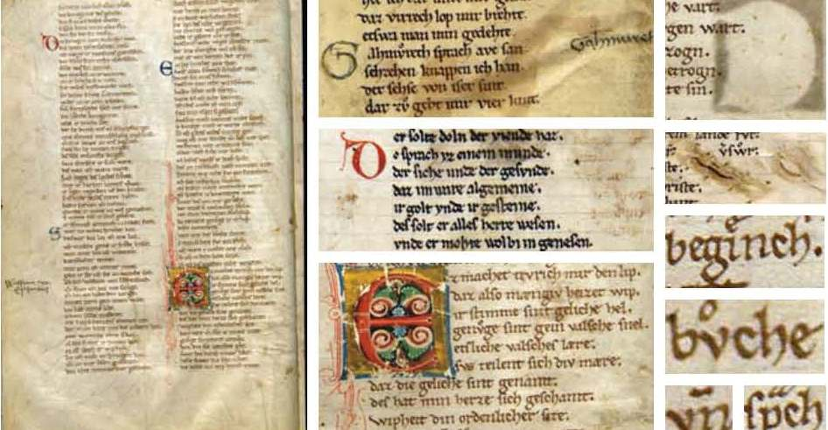
Application, Experimental Evaluation and Results: Recognition of Handwritten Historical Text

Slide 14
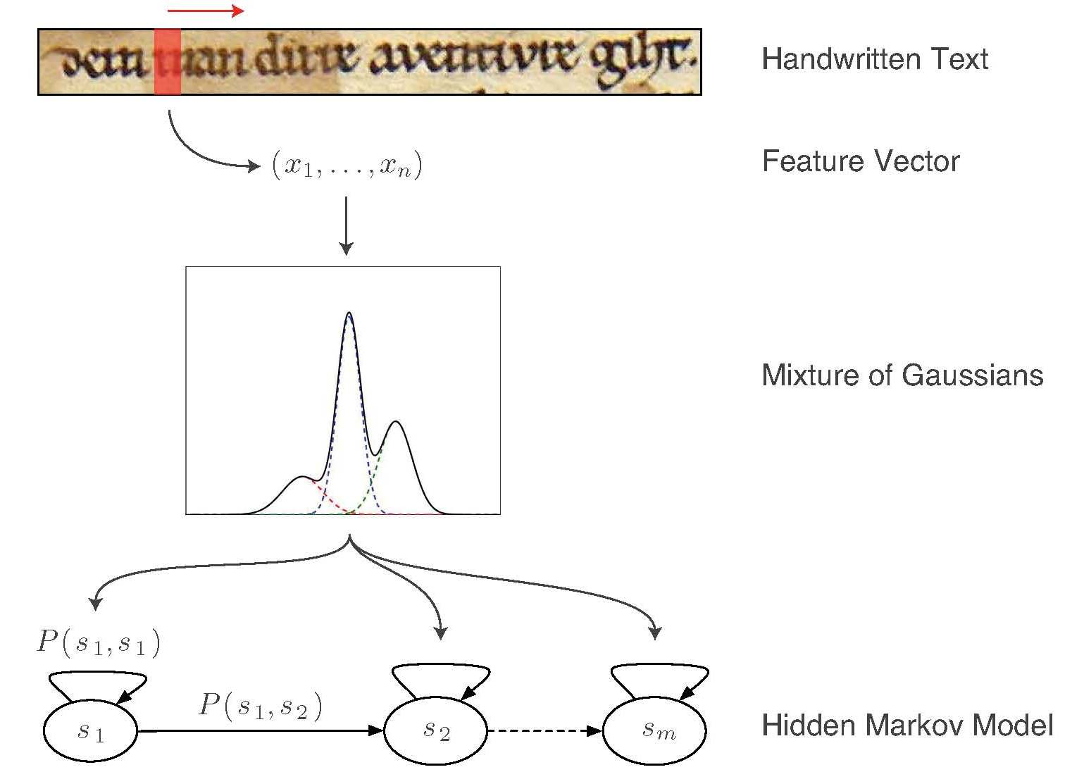
Conventional Approach

Slide 15
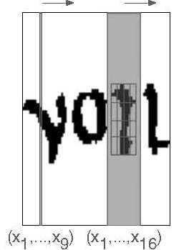
Conventional Features
Based on a sliding window, e.g. features by
Marti et al.: 9 features extracted from a window of 1 pixel width
Vinciarelli et al.: 16 windows of size 4 x 4 pixel; fraction of black pixels in each window; result: 16 features

Slide 16
Potential problem with conventional approach:
Two-dimensional shape of characters is not adequately modeled; no structural relations
Possible solution:
Use skeletons to represent the handwriting by a graph
Transform the graph of a handwritten text into a sequence of feature vectors
Apply HMMs or RNN to sequence of feature vectors

Slide 17
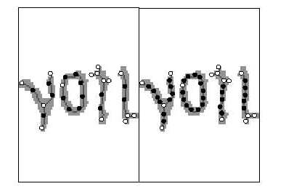
Graph Extraction
Apply a thinning operator to generate the skeleton of the image
Nodes:
Key points: crossings, junctions, end points, left-most points of circular arcs
Secondary points: equidistant points on the skeleton between key points; distance d is a parameter
Edges:
Nodes that are neighbors on the skeleton are connected by edges
However, in the experiments it turned out that the performance without edges is comparable to that with edges if parameter d is chosen appropriately; therefore, no edges were used

Slide 18
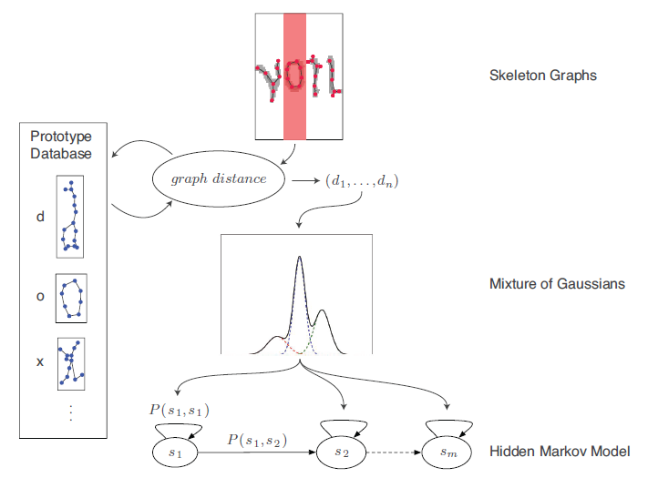
General Idea of Graph Based Approach

Slide 19
Experiments: Motivation and Aim
Typical graph size is about 30 nodes
The approximate ged using an assignment algorithm is still slow
Questions to be answered in the experiments:
How much speed-up do we gain with the H-distance based approach?
How much recognition accuracy do we loose?

Slide 20
Experimental Setup
Data: Parzival dataset
http://www.iam.unibe.ch/fki/databases/iam-historical-document-database
13th century manuscript written in Old German
Segmented into individual words
11,743 word instances (images)
3,177 word classes
79 character prototypes
Distance measures h, h‘, and h“ were normalized
Division of the database into training, validation, and test sets

Slide 21
Experimental Results
Word recognition rate on test set
h, h‘, h“ as introduced before; s based on assignment proc.
Computational speed (Java implementation)
Median graph size: 30 nodes
Median # of graph matchings per word: 6162
Run time in seconds
h | h‘ | h“ | s
49.78 | 83.95 | 93.66 | 94.00
graph size | # matchings | runtime of s | runtime of h“ | speedup
30 | 6,162 | 33.24 | 2.57 | 12.9

Slide 22
Conclusions
Ged is a powerful concept but is, in its original form, too slow for most applications
Various faster approximations of ged have been proposed
In this talk, a new approximate version with quadratic complexity is proposed, based on Hausdorff distance
It was practically evaluated in the context of a handwriting recognition task and has shown good results
Nevertheless, more experiments are needed, especially with other graph datasets (other attributes), and larger graphs; it would be interesting to compare the new distances „more directly“ with distances obtained from other apaproximate methods

Slide 23
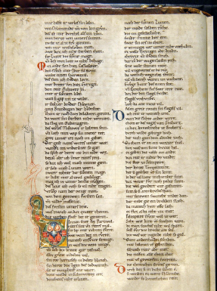
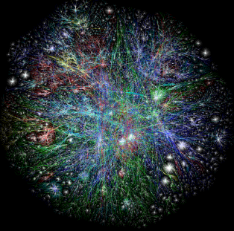
Acknowledments
HISDOC consortium: R. Ingold, J. Savoy, M. Bächler, N. Naji (collaborators in historical handwriting recognition project)
SNF (financial support for HISDOC)
SNF (postdoc stipend for AF)

