Slide 1
Improving Fuzzy Multilevel Graph Embedding
through Feature Selection Technique
Muhammad Muzzamil Luqman, Jean-Yves Ramel and Josep Lladós
mluqman@{univ-tours.fr, cvc.uab.es}
Graph-TA workshop, 19th February 2013

Slide 2
2
Objectives of research
Problematic
Lack of efficient computational tools for graph based structural pattern recognition
Proposed solution
Transform graphs into numeric feature vectors and exploit computational strengths of state of the art statistical pattern recognition

Slide 3
3
Outline of presentation
Whats/whys of graph embedding?
Fuzzy multilevel graph embedding (FMGE)
Feature selection by ranking discriminatory features
Experimental results
Conclusions

Slide 4
What is graph embedding?
Fuzzy Multilevel Graph Embedding
Feature selection
Experimentation
Conclusions
4
Structural and statistical PR
Pattern Recognition
Structural | Statistical
Data structure
Representational strength
Fixed dimensionality
Sensitivity to noise
Efficient computational tools
symbolic data structure | numeric feature vector
+
+
 | +
 | +

Slide 5
What is graph embedding?
Fuzzy Multilevel Graph Embedding
Feature selection
Experimentation
Conclusions
5
Graph embedding (GEM)
Structutal PR
Expressive,
convenient,
powerful but
computationally expensive representations
Statistical PR
Mathematically sound,
mature,
less expensive and computationally efficient models
Graph embedding

Slide 6
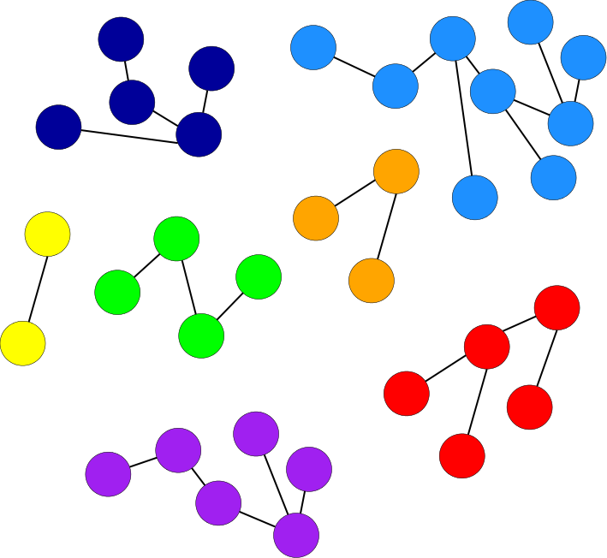
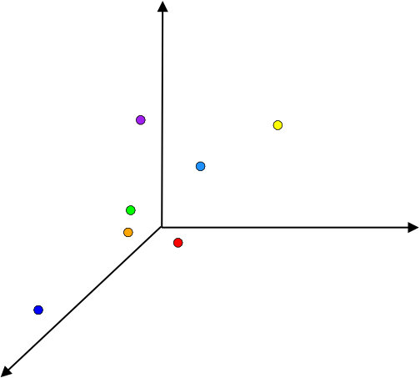
What is graph embedding?
Fuzzy Multilevel Graph Embedding
Feature selection
Experimentation
Conclusions
6
Graph embedding (GEM)

Slide 7
What is graph embedding?
Fuzzy Multilevel Graph Embedding
Feature selection
Experimentation
Conclusions
7
Explicit and implicit GEM
Explicit GEM
embeds each input graph into a numeric feature vector
provides more useful methods of GEM for PR
can be employed in a standard dot product for defining an implicit graph embedding function
Implicit GEM
computes scalar product of two graphs in an implicitly existing vector space, by using graph kernels
does not permit all the operations that could be defined on vector spaces

Slide 8
What is graph embedding?
Fuzzy Multilevel Graph Embedding
Feature selection
Experimentation
Conclusions
8
State of the art (explicit GEM)
Graph probing based methods
[Wiener, 1947] [Papadopoulos et al., 1999] [Gibert et al., 2011] [Sidere, 2012]
Spectral based graph embedding
[Harchaoui, 2007] [Luo et al., 2003] [Robleskelly and Hancock, 2007]
Dissimilarity based graph embedding
[Pekalska et al., 2005] [Ferrer et al., 2008] [Riesen, 2010] [Bunke et al., 2011]

Slide 9
9
Outline of presentation
Whats/whys of graph embedding?
Fuzzy multilevel graph embedding (FMGE)
Feature selection by ranking discriminatory features
Experimental results
Conclusions

Slide 10
What is graph embedding?
Fuzzy Multilevel Graph Embedding
Feature selection
Experimentation
Conclusions
10
FMGE
Fuzzy Multilevel Graph Embedding (FMGE) [Luqman et al., 2012]
Graph probing based explicit graph embedding method
[Luqman et al., Fuzzy multilevel graph embedding, Pattern Recognition, 2012.]

Slide 11
What is graph embedding?
Fuzzy Multilevel Graph Embedding
Feature selection
Experimentation
Conclusions
11
FMGE
Input : Collection of attributed graphs
Output : Equal-size numeric feature vector for each input graph

Slide 12
What is graph embedding?
Fuzzy Multilevel Graph Embedding
Feature selection
Experimentation
Conclusions
12
Extracting details from graph
Multilevel analysis of graph
Graph Level Information
[macro details]
Graph order
Graph size
Structural Level Information
[intermediate details]
Node degree
Homogeneity of subgraphs in graph
Elementary Level Information
[micro details]
Node attributes
Edge attributes
Numeric feature vector embeds a graph, encoding:
Numeric information by fuzzy histograms
Symbolic information by crisp histograms

Slide 13
What is graph embedding?
Fuzzy Multilevel Graph Embedding
Feature selection
Experimentation
Conclusions
13
Homogeneity of subgraphs in a graph
Node-resemblance for an edge
Edge-resemblance for a node

Slide 14
What is graph embedding?
Fuzzy Multilevel Graph Embedding
Feature selection
Experimentation
Conclusions
14
Homogeneity of subgraphs in a graph
Node-resemblance for an edge
Edge-resemblance for a node
a₁
b₁
a
b
a₂
b₂

Slide 15
What is graph embedding?
Fuzzy Multilevel Graph Embedding
Feature selection
Experimentation
Conclusions
15
Homogeneity of subgraphs in a graph
Node-resemblance for an edge
Edge-resemblance for a node
a₃
b₃
a₁
b₁
a
b
a₂
b₂

Slide 16
What is graph embedding?
Fuzzy Multilevel Graph Embedding
Feature selection
Experimentation
Conclusions
16
Encoding extracted information
Unsupervised learning phase
Graph embedding phase

Slide 17
What is graph embedding?
Fuzzy Multilevel Graph Embedding
Feature selection
Experimentation
Conclusions
17
Unsupervised learning phase of FMGE

Slide 18
What is graph embedding?
Fuzzy Multilevel Graph Embedding
Feature selection
Experimentation
Conclusions
18
Unsupervised learning phase of FMGE
2 3 4 5 6 7 8 9
First fuzzy interval (-∞, -∞, …, …)
Last fuzzy interval (…, …, ∞, ∞)

Slide 19
What is graph embedding?
Fuzzy Multilevel Graph Embedding
Feature selection
Experimentation
Conclusions
19
Graph embedding phase of FMGE
Numeric information embedded by fuzzy histograms
Symbolic information embedded by crisp histograms

Slide 20
What is graph embedding?
Fuzzy Multilevel Graph Embedding
Feature selection
Experimentation
Conclusions
20
Fuzzy Structural Multilevel Feature Vector
Feature vector of FMGE
Graph Level Information
[macro details]
Structural Level Information
[intermediate details]
Elementary Level Information
[micro details]
Graph order | Graph size
Fuzzy histogram of node degrees | Fuzzy histograms of numeric resemblance attributes | Crisp histograms of symbolic resemblance attributes
Fuzzy histograms of numeric node attributes | Crisp histograms of symbolic node attributes | Fuzzy histograms of numeric edge attributes | Crisp histograms of symbolic edge attributes

Slide 21
21
Outline of presentation
Whats/whys of graph embedding?
Fuzzy multilevel graph embedding (FMGE)
Feature selection by ranking discriminatory features
Experimental results
Conclusions

Slide 22
What is graph embedding?
Fuzzy Multilevel Graph Embedding
Feature selection
Experimentation
Conclusions
22
Why feature Selection?
Large number of features enable FMGE to achieve generalization to diverse graphs in an unsupervised fashion
BUT
also results into high dimensionality and sparsity of feature vector!

Slide 23
What is graph embedding?
Fuzzy Multilevel Graph Embedding
Feature selection
Experimentation
Conclusions
23
Ranking discriminatory features
Relief algorithm based feature selection [Kira et al., 1992]
For each instance of a given feature, the near-hit (closest value among elements of same class) and the near-miss (closest value among element of other classes) are computed
A weight w_{f}, is calculated for every feature in terms of the distances of each sample x, to its near-hit and near miss
n top-ranked (high discriminatory) features are selected

Slide 24
24
Outline of presentation
Whats/whys of graph embedding?
Fuzzy multilevel graph embedding (FMGE)
Feature selection by ranking discriminatory features
Experimental results
Conclusions and future research challenges

Slide 25
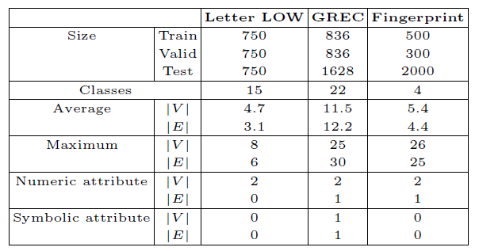
What is graph embedding?
Fuzzy Multilevel Graph Embedding
Feature selection
Experimentation
Conclusions
25
Graph database
IAM graph database [Riesen et al., 2008]

Slide 26
What is graph embedding?
Fuzzy Multilevel Graph Embedding
Feature selection
Experimentation
Conclusions
26
Parameter validation
Two parameters validated on “validation set”:
Number of fuzzy intervals for embedding numeric information
2 to 25 (in steps of 1)
Selection of n top-ranked features
All subsets of high to low ranked features (i.e. top-1, top-2, top-3 ...)

Slide 27
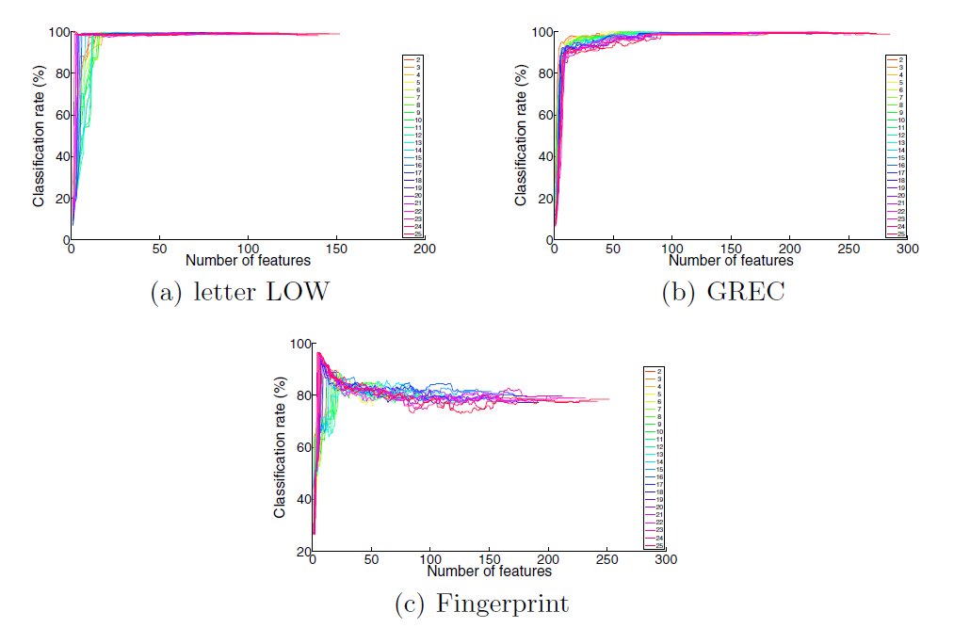
What is graph embedding?
Fuzzy Multilevel Graph Embedding
Feature selection
Experimentation
Conclusions
27
Parameter validation
Validation results showing the classification rates obtained for different subsets of n top-ranked features for the 25 configurations of FMGE. The horizontal axis gives top-n features (sorted high to low ranked by Relief algorithm).

Slide 28
What is graph embedding?
Fuzzy Multilevel Graph Embedding
Feature selection
Experimentation
Conclusions
28
Experimental results
495
495
495
61
30
61
Results on test sets - IAM graph database. “CR” is the classification rate (%) obtained by k-nn classifier and “DIM” is the dimensionality of feature vector.

Slide 29
29
Outline of presentation
Whats/whys of graph embedding?
Fuzzy multilevel graph embedding (FMGE)
Feature selection by ranking discriminatory features
Experimental results
Conclusions

Slide 30
What is graph embedding?
Fuzzy Multilevel Graph Embedding
Feature selection
Experimentation
Conclusions
30
Conclusions
Feature selection successfully improves the performance of FMGE
Low dimensionality
Reduced compuation time for classification
Improved classification rate
Provides a deep insight into the groups of features that are discriminatory and the features that are not very useful for a graph dataset
More compact and discriminatory feature vector representation of graphs

Slide 31
What is graph embedding?
Fuzzy Multilevel Graph Embedding
Feature selection
Experimentation
Conclusions
31
Future research challenges
Other sophisticated feature selection techniques
Add more topological information to FMGE

Slide 32
Improving Fuzzy Multilevel Graph Embedding
through Feature Selection Technique
Muhammad Muzzamil Luqman, Jean-Yves Ramel and Josep Lladós
mluqman@{univ-tours.fr, cvc.uab.es}
Graph-TA workshop, 19th February 2013

