Slide 1
Dynamic Data Partitioning for Distributed Graph Databases
Xavier Martínez Palau
David Domínguez Sal
Josep Lluís Larriba Pey

Slide 2
Outline
Introduction
Contributions
System Overview
Experiments

Slide 3
Outline
Introduction
Contributions
System Overview
Experiments

Slide 4
Introduction: Databases
Database
Software to store large amounts of data
High performance
Several ways to store a graph
Graph database
Relational database
RDF
Key-value datastore
…

Slide 5
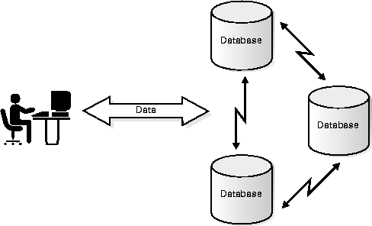
Distributed Databases
Distributed databases store more data and improve throughput

Slide 6
Outline
Introduction
Contributions
System Overview
Experiments

Slide 7
Contributions
System design in two levels
Physical storage
Memory management
Data access pattern monitoring
Specific data structure
Load and network balancing
Increased throughput

Slide 8
Outline
Introduction
Contributions
System Overview
Experiments

Slide 9
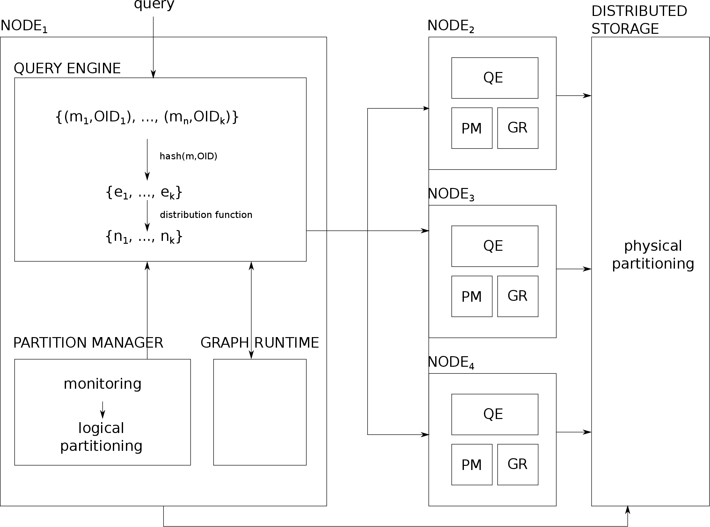
System Overview
Memory managment
Storage

Slide 10
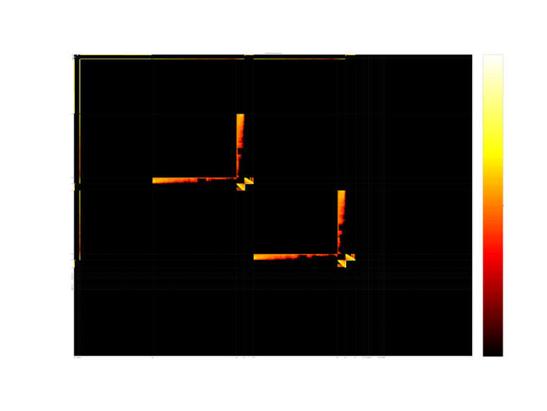
Partition Manager
We propose a new data structure
Monitors data access patterns
Uses this information in a simple way to decide how to route queries
Matrix of data access sequences
New compressed data structure

Slide 11
Outline
Introduction
Contributions
System Overview
Experiments

Slide 12
Experiments
Scalability with cluster size
Tested up to 32 machines
Systems compared
Static partitioning
Dynamic partitioning (ours)
R-MAT graph
37M vertices
1B edges
Queries: BFS and k-hops

Slide 13
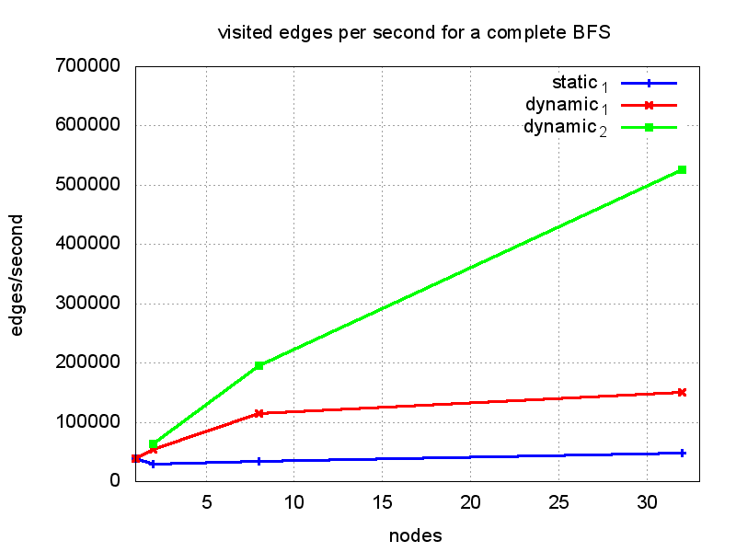
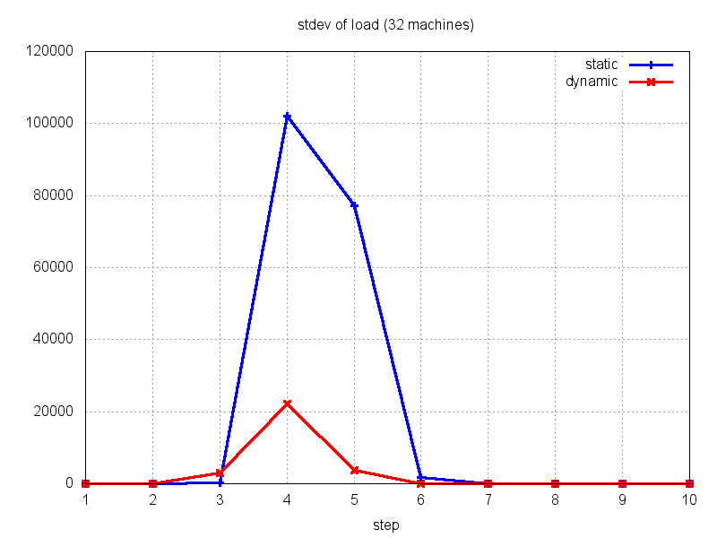
Experiments
Throughput (more better)
Imbalance (less better)

