Slide 1
Vector Space Embedding of Graphs via Statistics of Labelling Information
Ernest Valveny
Computer Vision Center
Computer Science Departament - UAB

Slide 2
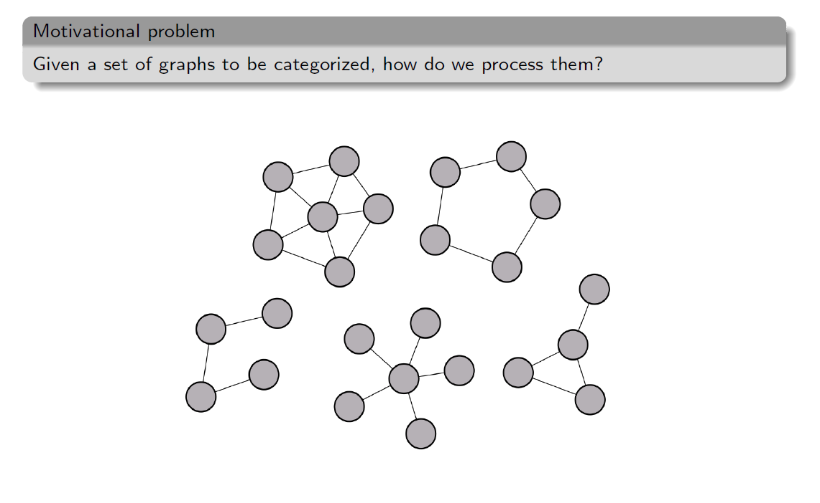
Problem to be solved

Slide 3
How do we solve the problem?

Slide 4
Motivation (discrete case)

Slide 5
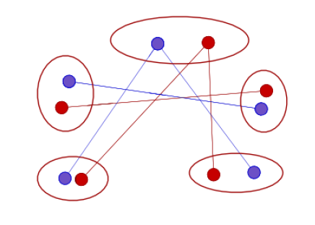
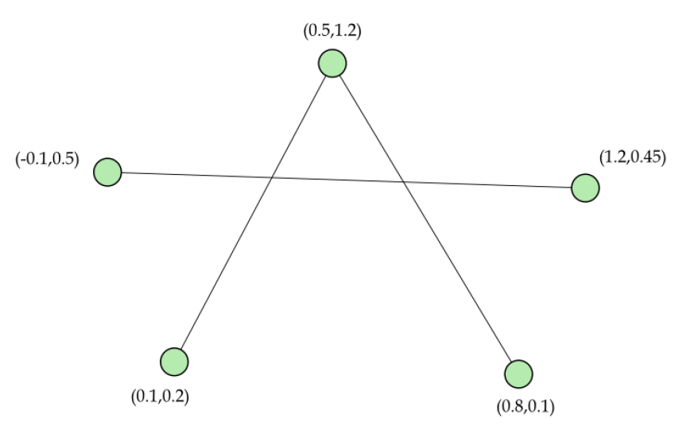
Extension to continuous case

Slide 6
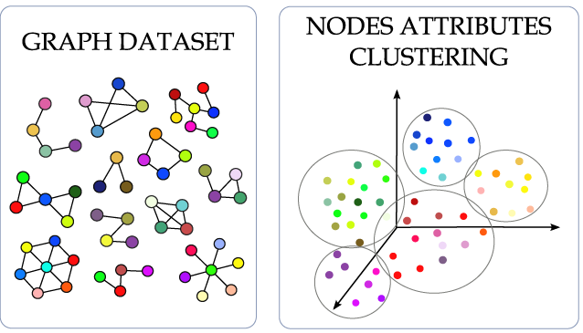
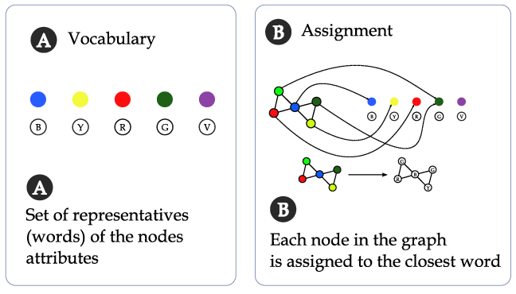
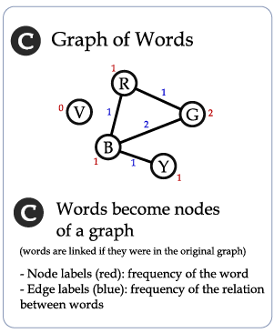
Extension to continuous case

Slide 7
Extension to continuous case (hard version)

Slide 8
Extension to continuous case (soft version)
Soft assignment of nodes to representatives
The frequency of each word is the accumulation for all nodes

Slide 9
Some issues
Selection of the set of representatives
K-means
Fuzzy k-means
Spanning prototypes
Mixture of gaussians
Sparsity and high-dimensionality of representation
Feature selection
Combination of different sets of representatives
Multiple classifier systems with different number of representatives

Slide 10
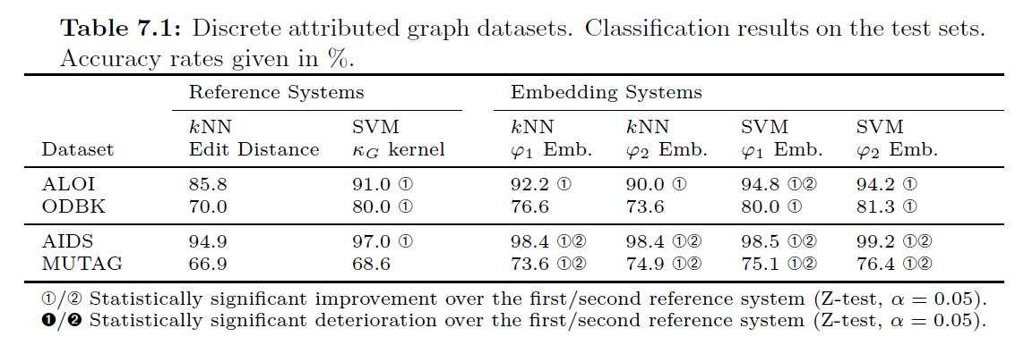
Some results (discrete case)

Slide 11
Some results (continuous case)

Slide 12
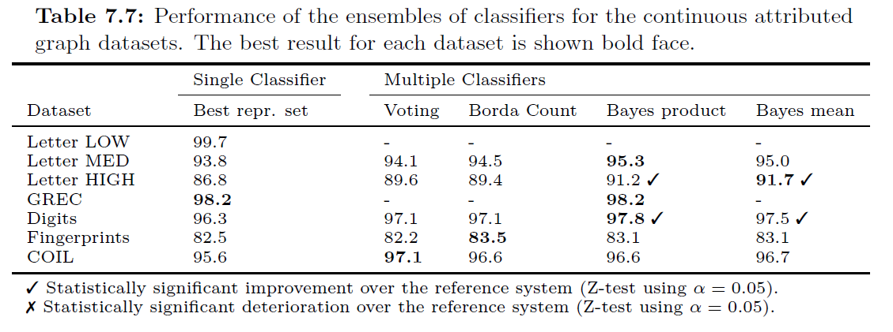
Some results (continuous case)

Slide 13
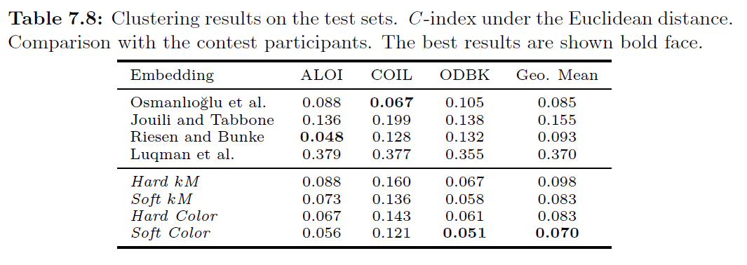
Some results (continuous case)

Slide 14
Conclusions
Simple embedding methodology
Computationally efficient
Based on unary and binary relations between nodes
Good results for classification and clustering

