Slide 1
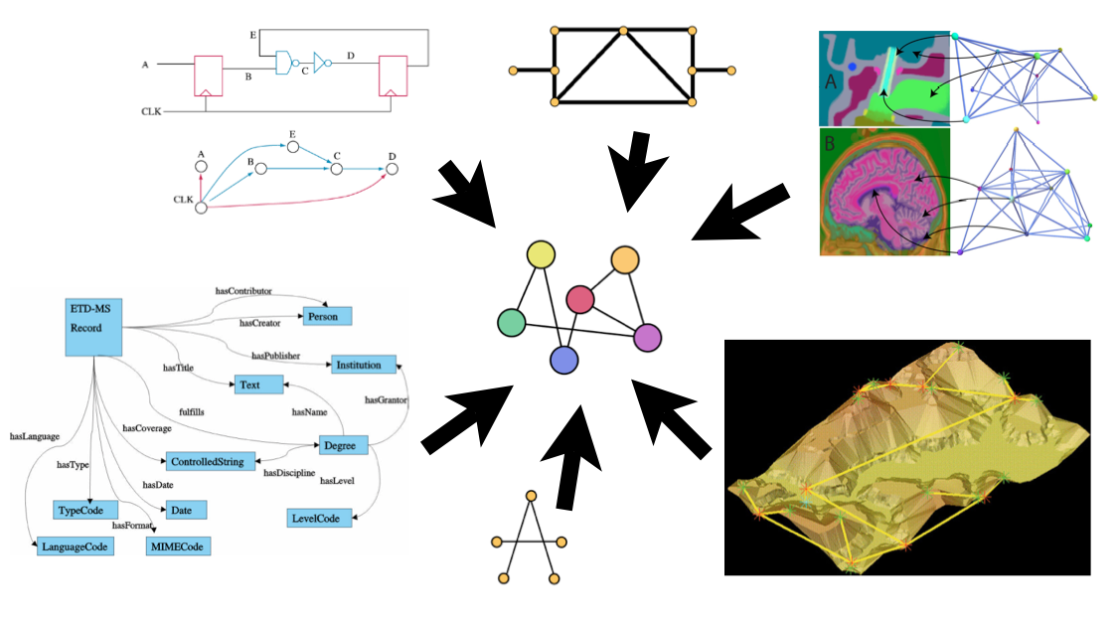
Learning Weights for Graph Matching Edit Costs
Francesc Serratosa, Xavier Cortés & Carlos Moreno
Universitat Rovira i Virgili

Slide 2
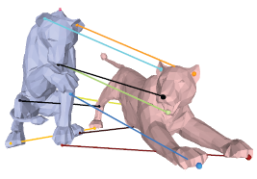
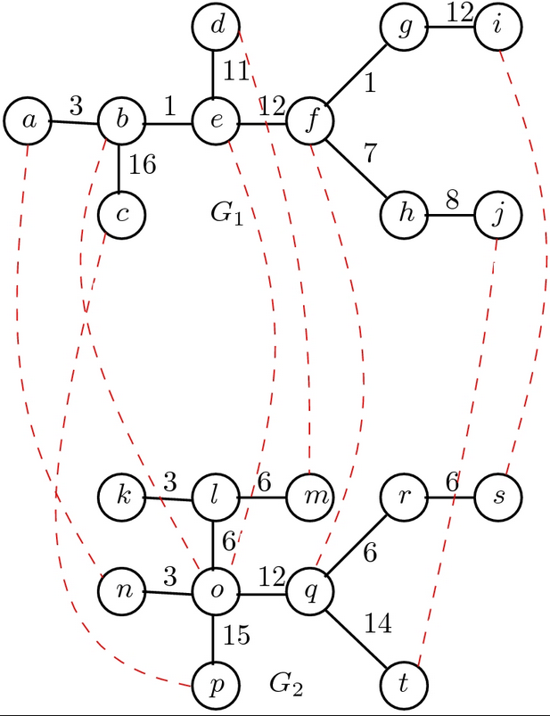
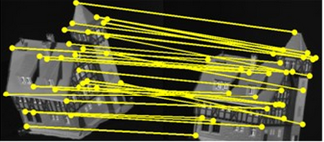
Graph Matching

Slide 3
Graph Matching

Slide 4
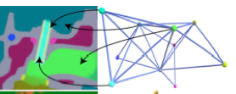
Graph Matching

Slide 5
Graph Matching

Slide 6
Graph Matching

Slide 7
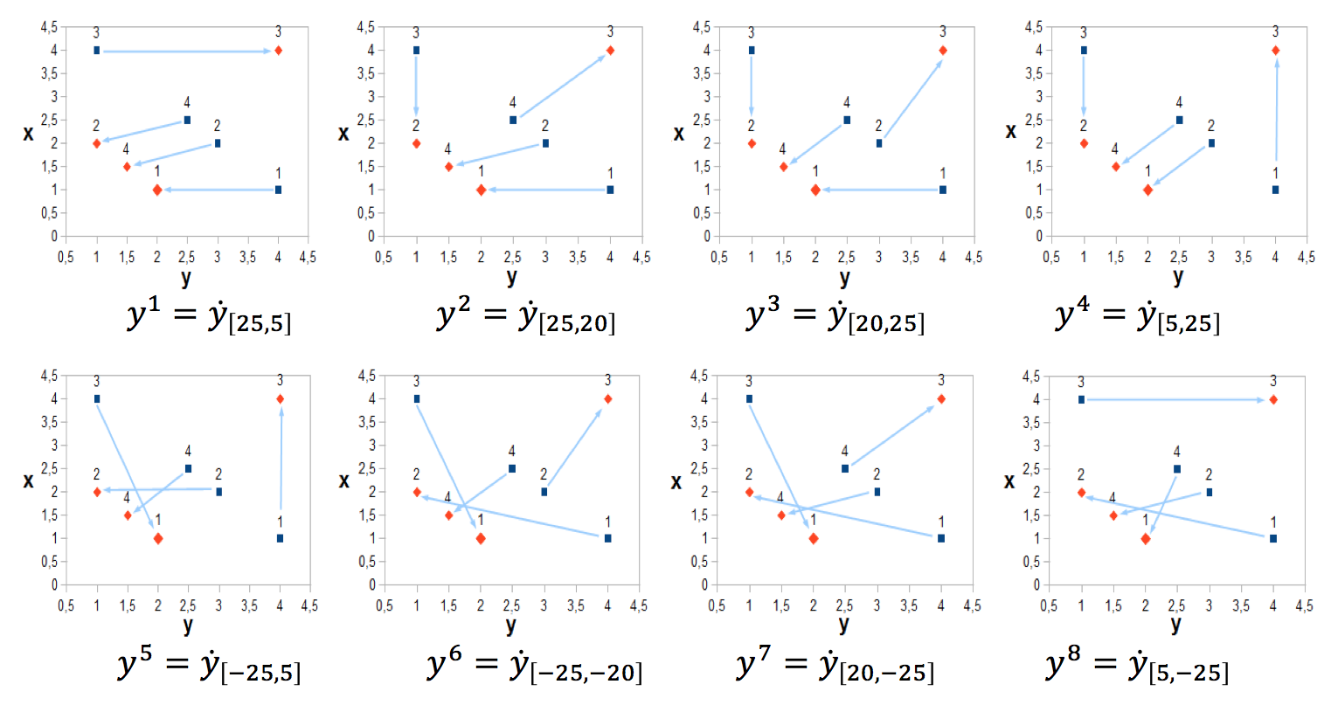
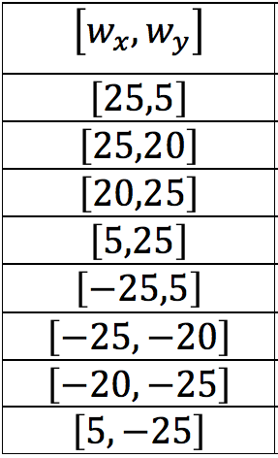
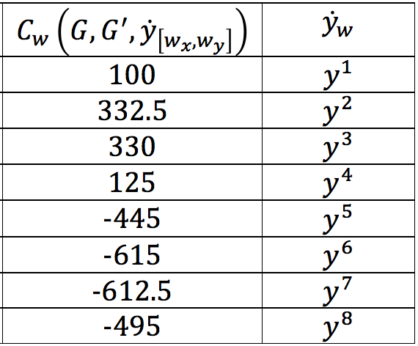
Example

Slide 8
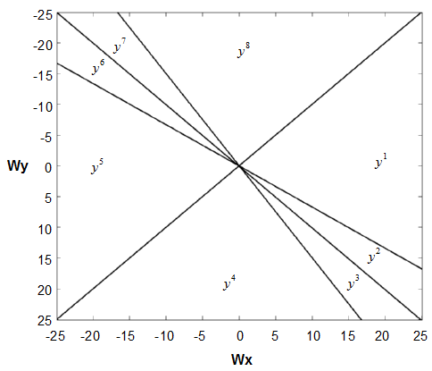
Labelling Space
A. Solé, F. Serratosa & A. Sanfeliu, On the Graph Edit Distance cost: Properties and Applications, IJPRAI 2012

Slide 9
Labelling Space
A. Solé, F. Serratosa & A. Sanfeliu, On the Graph Edit Distance cost: Properties and Applications, IJPRAI 2012

Slide 10
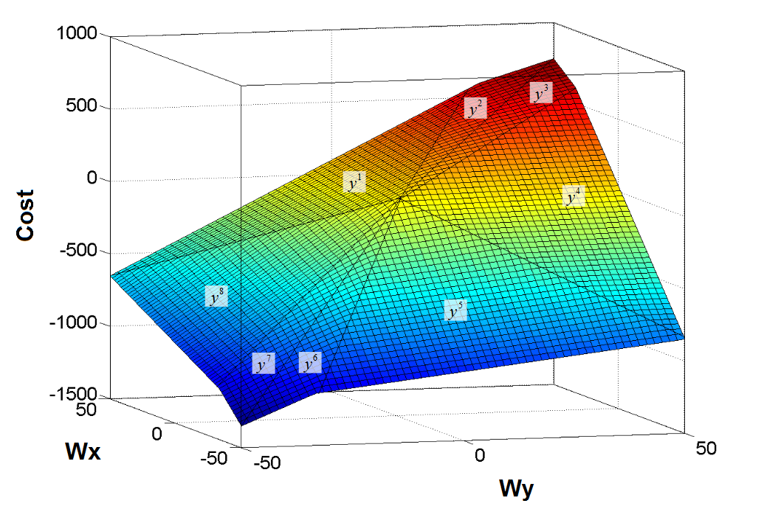
Labelling Space
A. Solé, F. Serratosa & A. Sanfeliu, On the Graph Edit Distance cost: Properties and Applications, IJPRAI 2012

Slide 11
Learning Weights

Slide 12
Learning Weights
Loss Function
Regularisation term

Slide 13
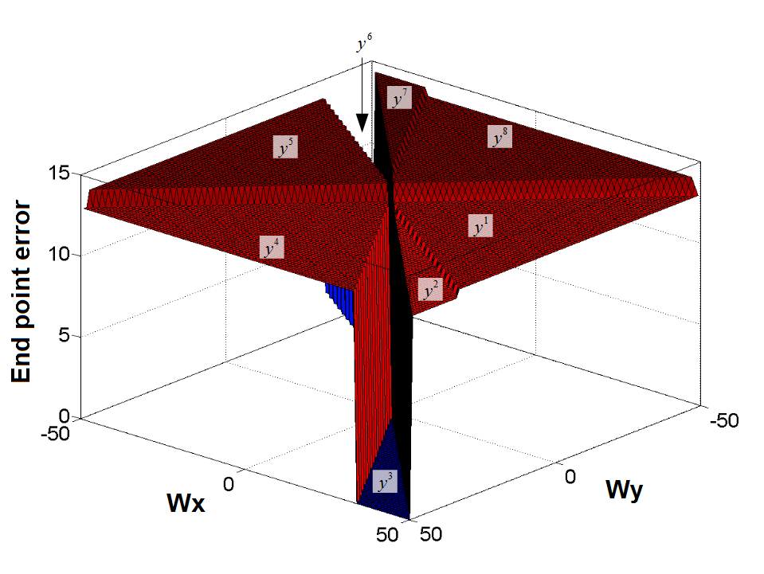
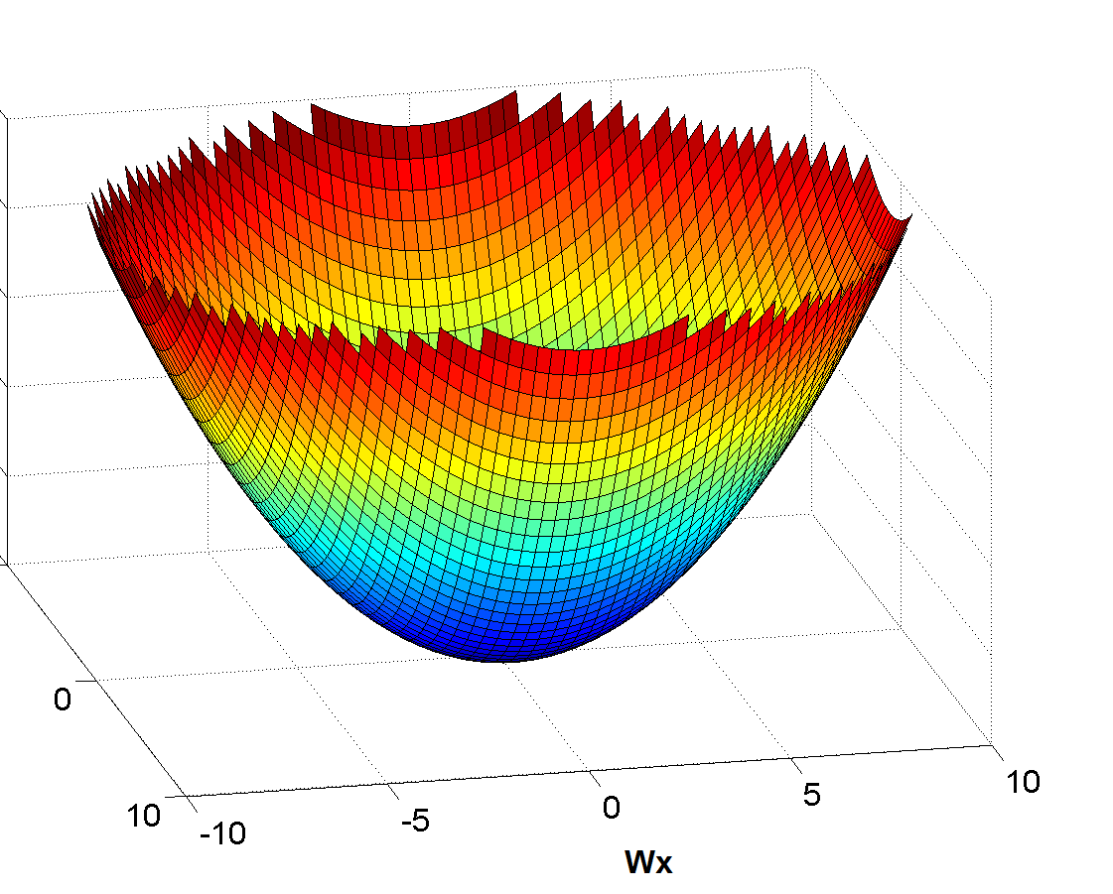
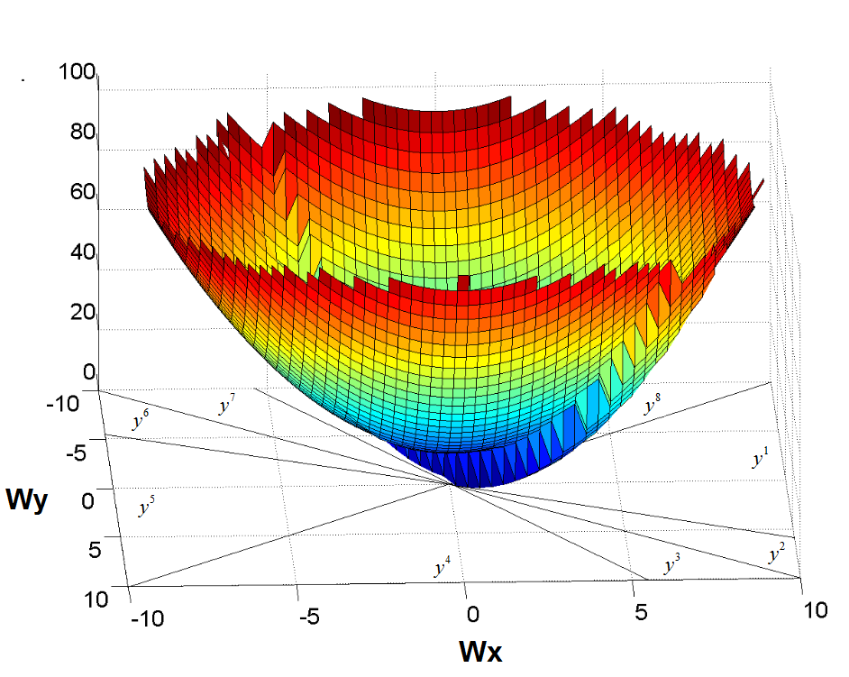
Learning Weights
Loss Function
Regularisation term
T. S. Caetano, J. J. McAuley, L. Cheng, Q. V. Le, A. J. Smola, “Learning Graph Matching”, PAMI 2009

Slide 14
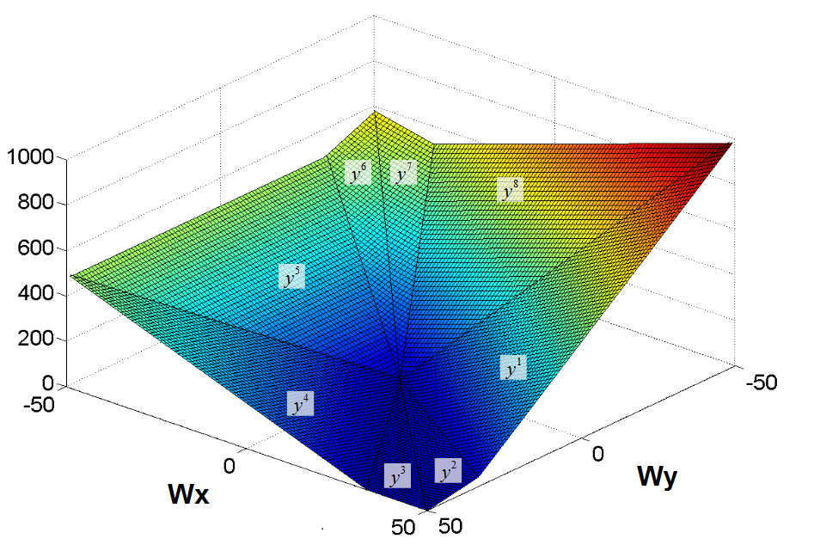
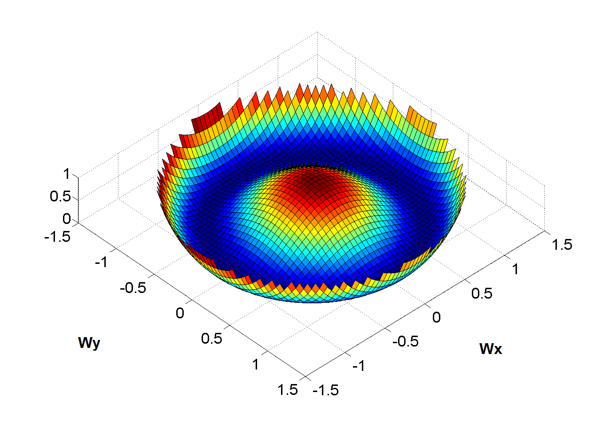
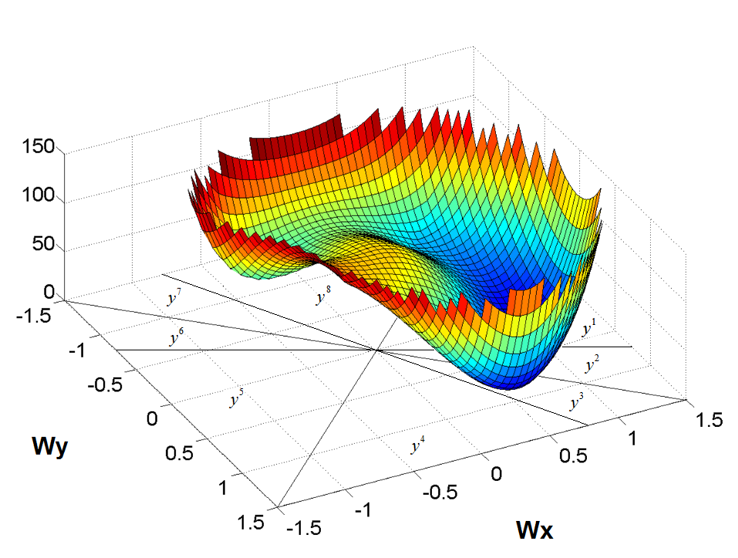
Learning Weights
Loss Function
Regularisation term
Our method

Slide 15
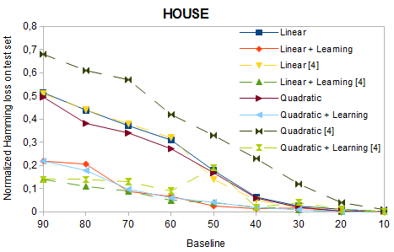
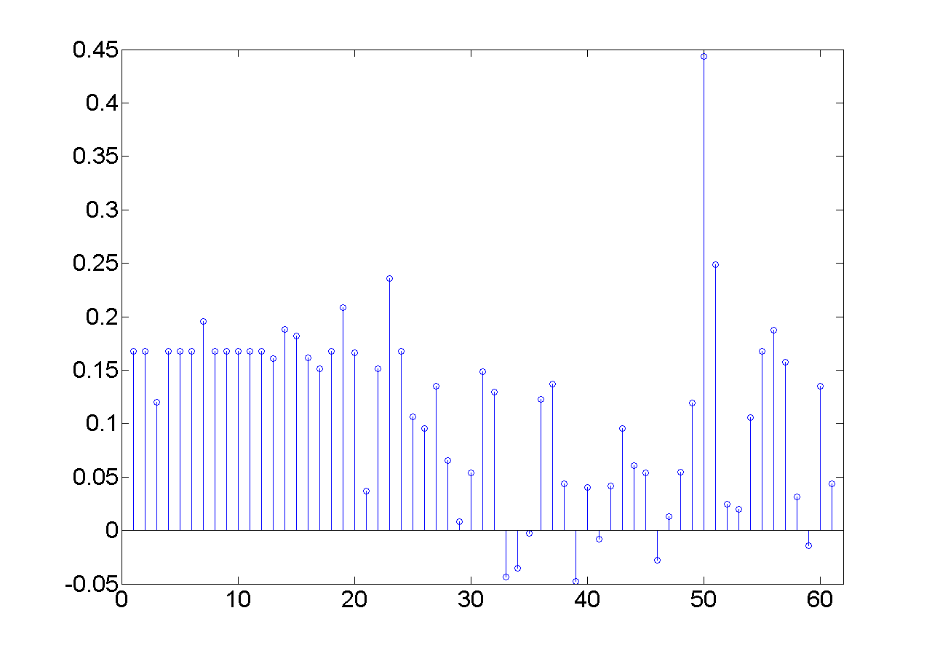
Practical Evaluation

Slide 16
Conclusions
We demonstrate the parameter on the regularisation term does not affect on the optimisation process, thus, it is not needed to tune it in the validation process, as it is usual in other methods.
We show the optimisation algorithm only uses the weights on nodes and edges and it is not needed external variables such as the node positions, as it is usual in other methods.

