Slide 1
Overlapping Community Search for Social Networks
Arnau Padrol, Guillem Perarnau, Julian Pfeifle, Victor Muntés Mulero
GRAPH-TA, Barcelona, February 2014

Slide 2
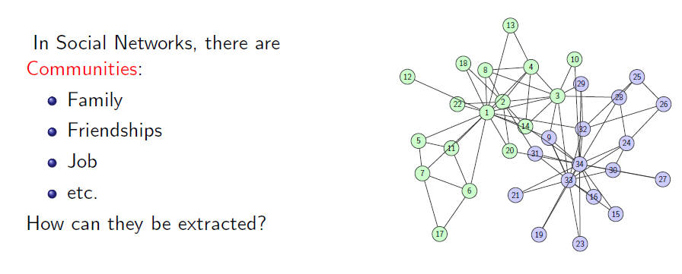
The Problem

Slide 3
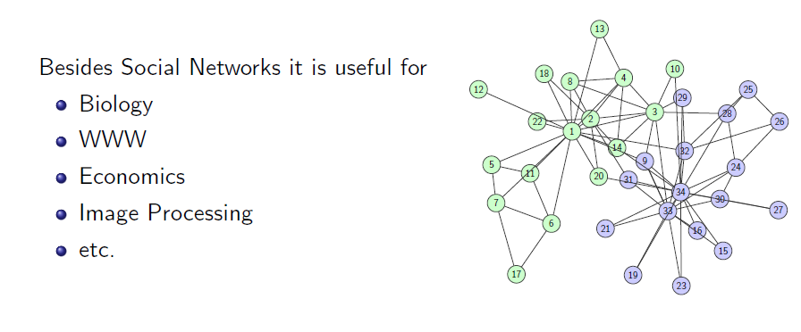
The Problem

Slide 4
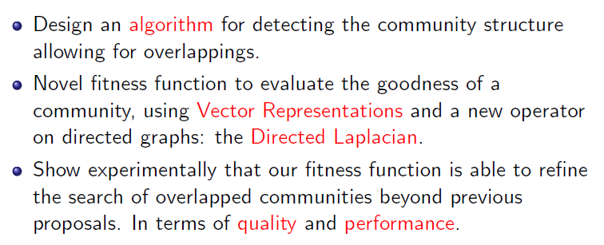
Major Contributions

Slide 5
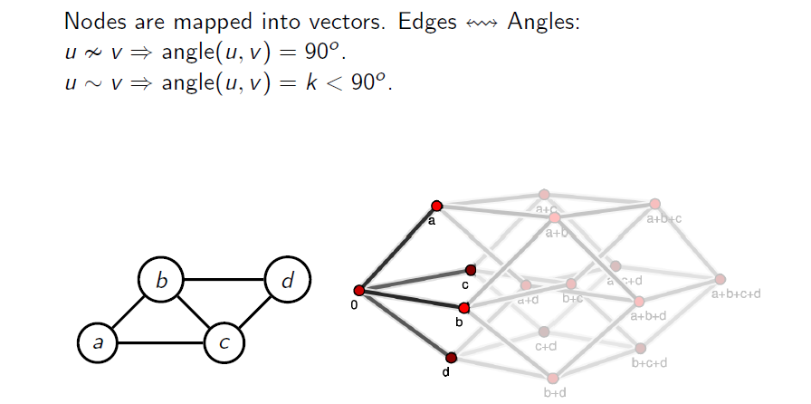
Vector Representation

Slide 6
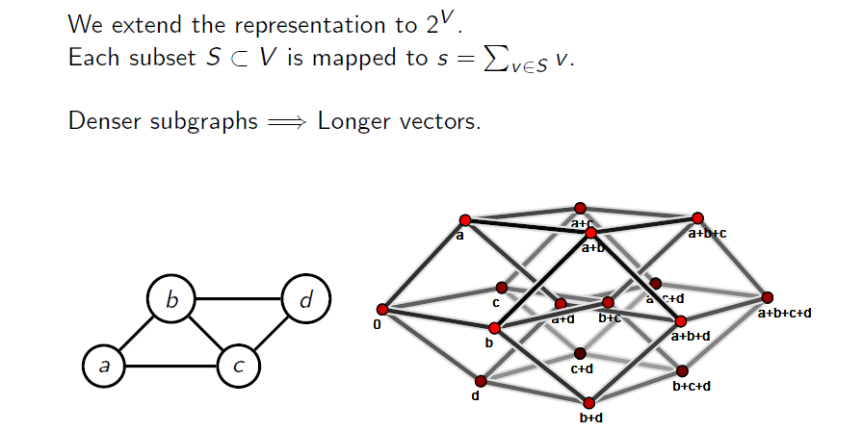
Vector Representation

Slide 7
Vector Representation

Slide 8
Directed Laplacian

Slide 9
Directed Laplacian

Slide 10
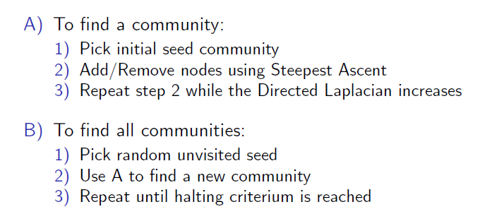
OCA: Overlapped Community Algorithm

Slide 11
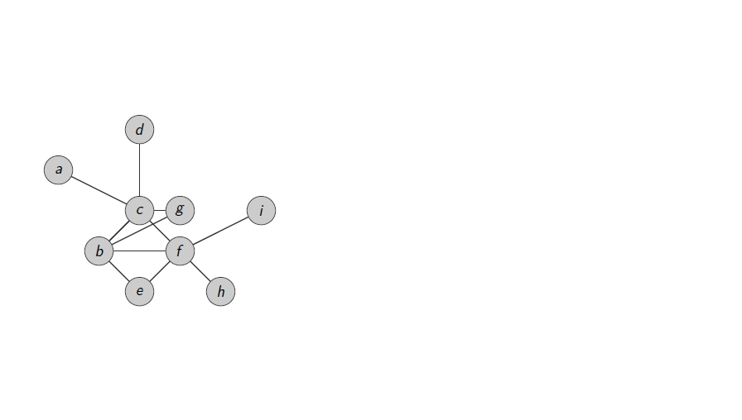
OCA: Overlapped Community Search

Slide 12
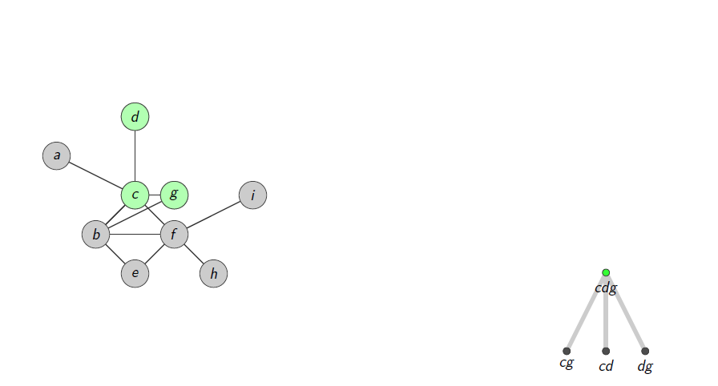
OCA: Overlapped Community Search

Slide 13
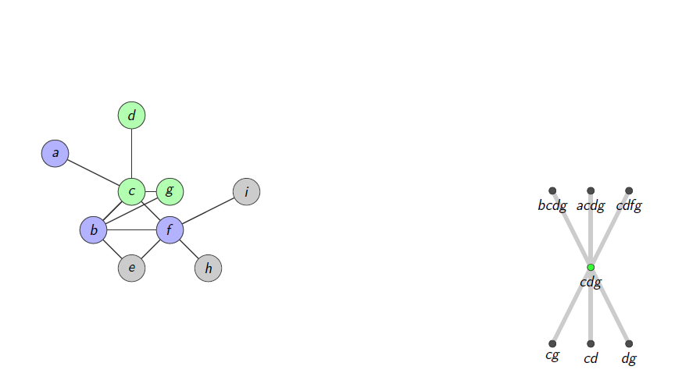
OCA: Overlapped Community Search

Slide 14
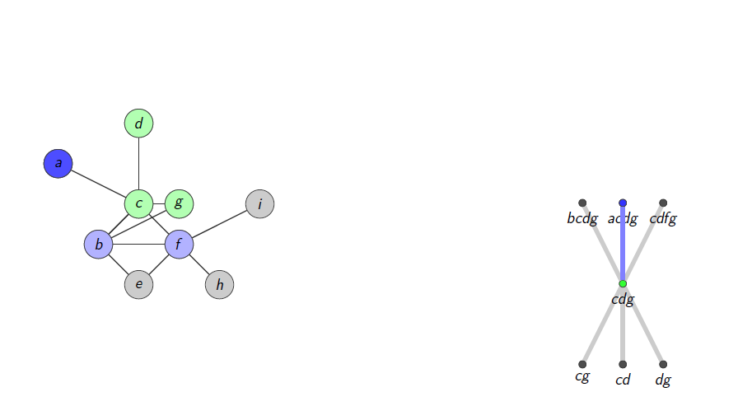
OCA: Overlapped Community Search

Slide 15
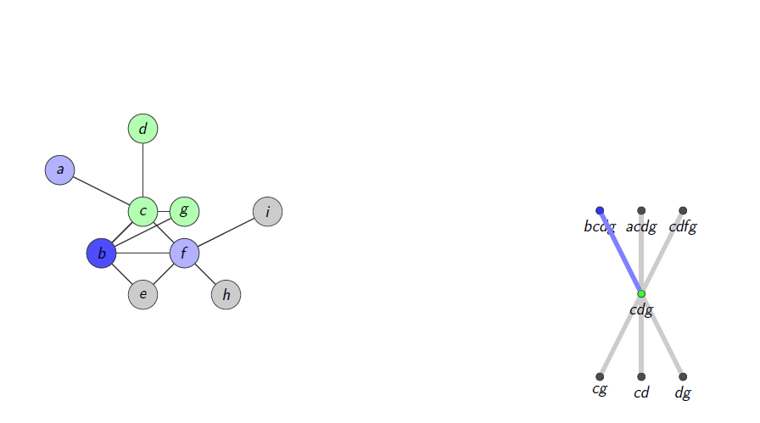
OCA: Overlapped Community Search

Slide 16
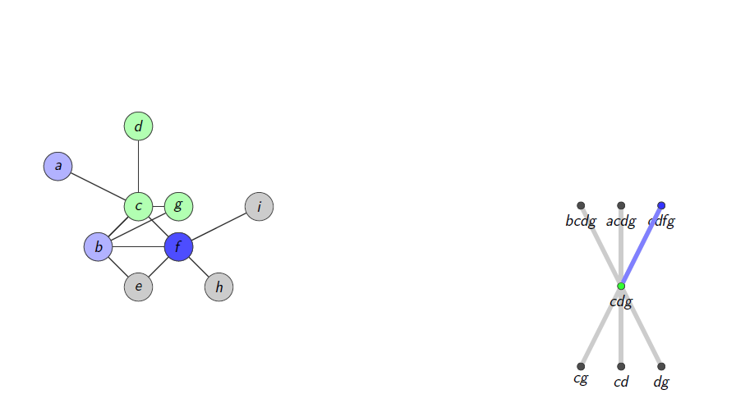
OCA: Overlapped Community Search

Slide 17
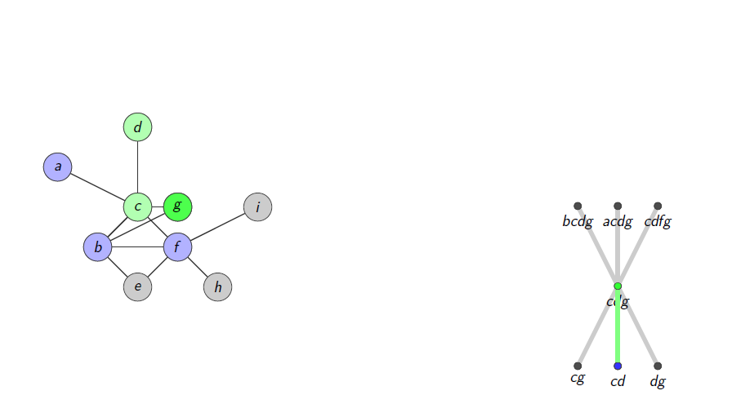
OCA: Overlapped Community Search

Slide 18
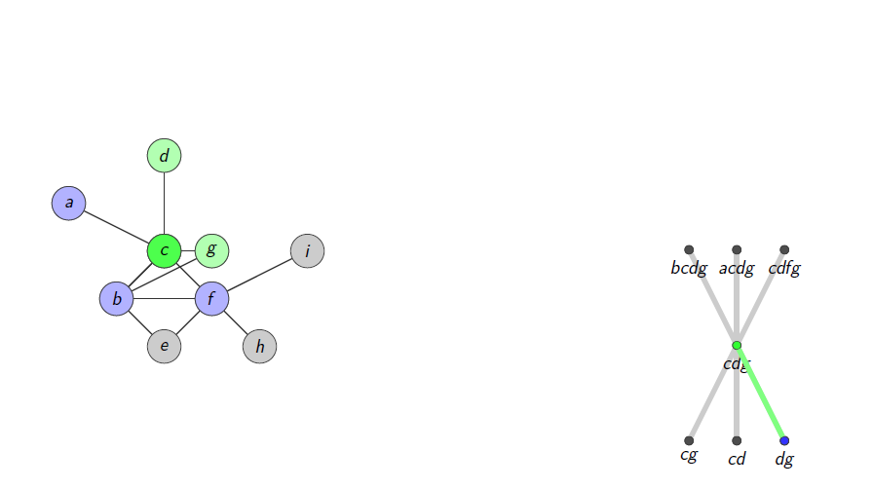
OCA: Overlapped Community Search

Slide 19
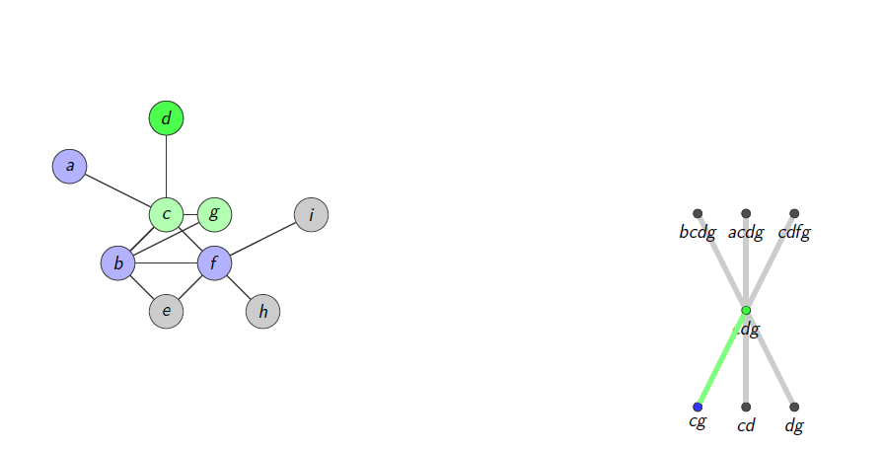
OCA: Overlapped Community Search

Slide 20
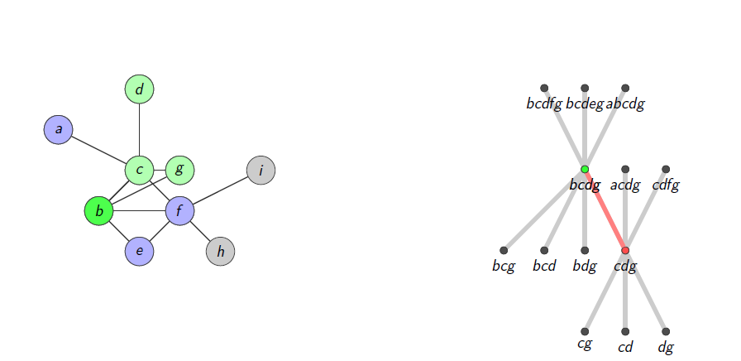
OCA: Overlapped Community Search

Slide 21
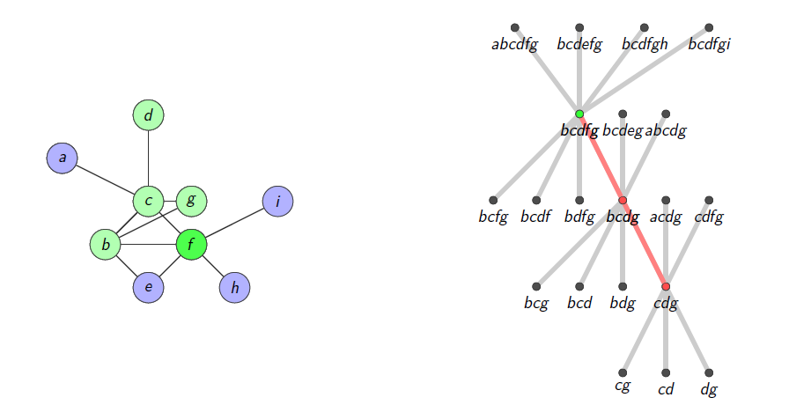
OCA: Overlapped Community Search

Slide 22
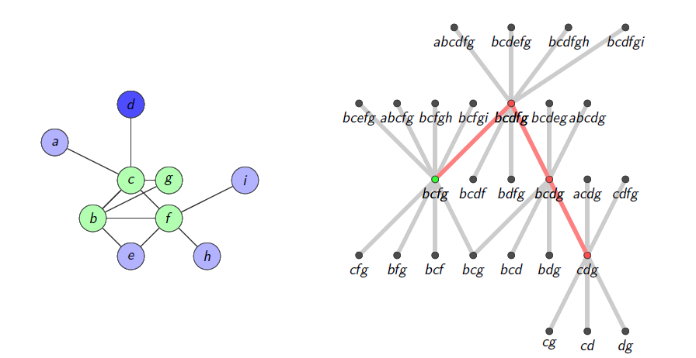
OCA: Overlapped Community Search

Slide 23
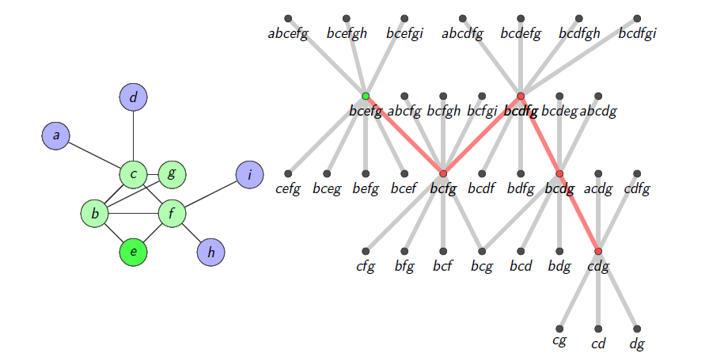
OCA: Overlapped Community Search

Slide 24
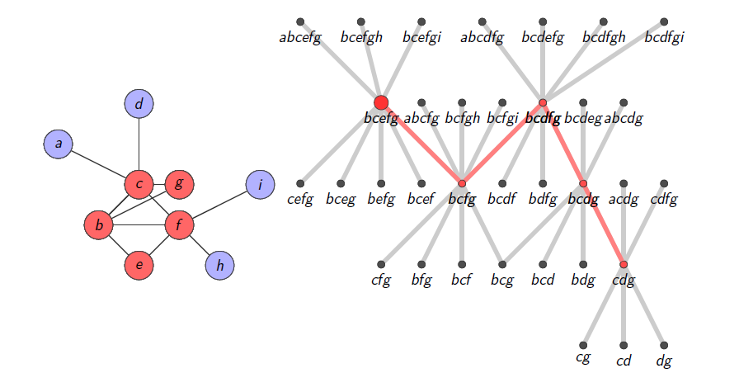
OCA: Overlapped Community Search

Slide 25
Victor Muntés Mulero
VP & Research Director CA Labs
Victor.Muntes@ca.com
@cainc
slideshare.net/CAinc
linkedin.com/company/ca-technologies
ca.com

Slide 26
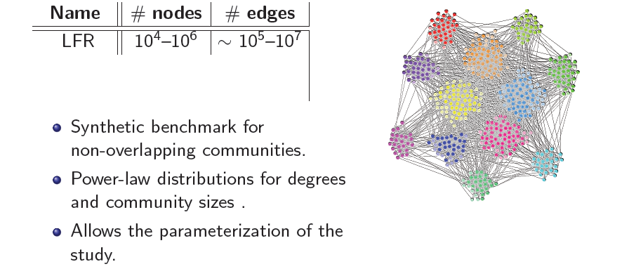
The Gallery of Graphs Tested

Slide 27
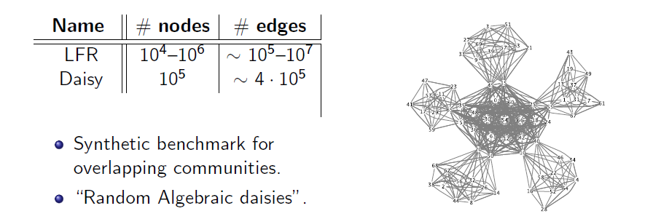
The Gallery of Graphs Tested

Slide 28
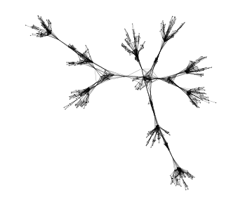
The Gallery of Graphs Tested

Slide 29
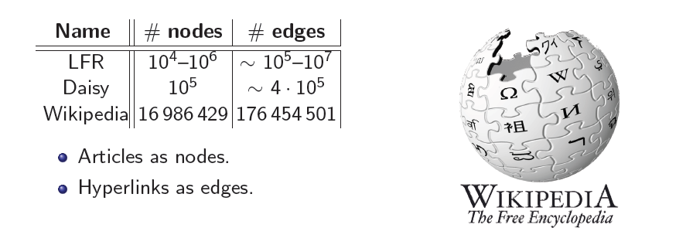
The Gallery of Graphs Tested

Slide 30
A Similarity Measure

Slide 31
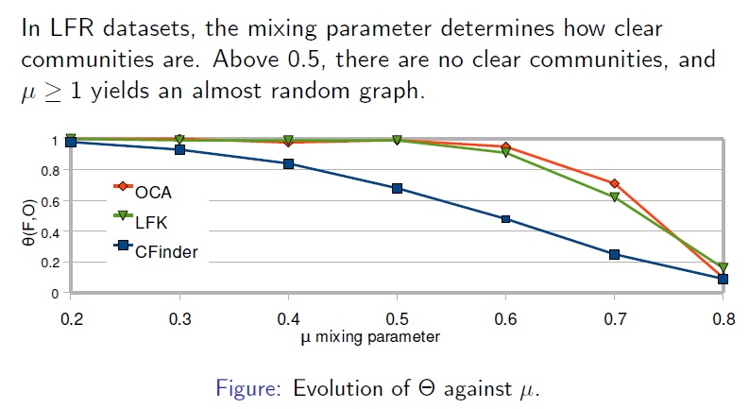
Quality on LFR

Slide 32
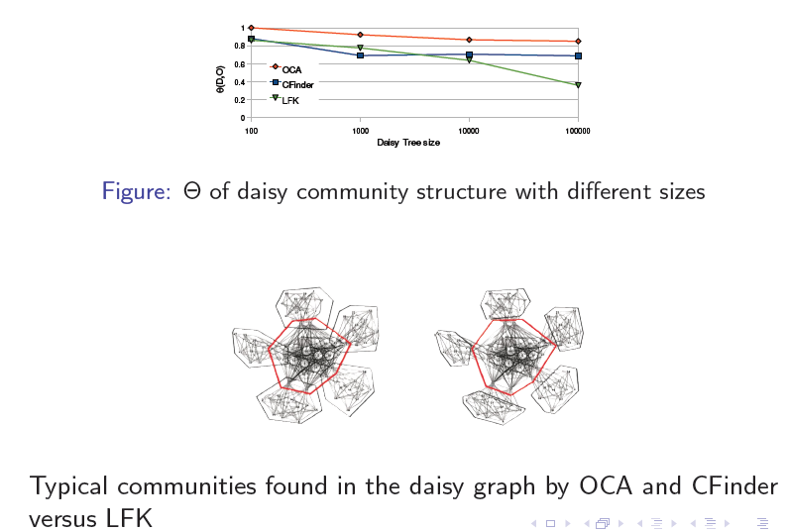
Quality on Daisy Graphs

Slide 33
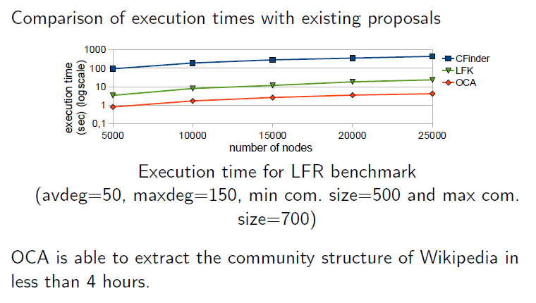
Performance

