Slide 1
Hierarchical Floorplanning of Chip Multiprocessors using Subgraph Discovery
Javier de San Pedro
Jordi Cortadella
Antoni Roca
Universitat Politècnica de Catalunya (Barcelona)

Slide 2
Outline
Introduction
Chip multiprocessors and floorplanning
Hierarchical floorplanning methodology
Results and conclusions

Slide 3
What is a Chip Multiprocessor?
Core
Core
Core
Core
L1 Cache
L1 Cache
L1 Cache
L1 Cache
L2 Cache
L2 Cache
L2 Cache
L2 Cache
Interconnect
Router
Router
Router
Router
Router
Router
L3 Cache
Off-Chip Memory

Slide 4
What is floorplanning?
MC
MC
MC
MC
C
C
R
L2
L2
Ring
L2
L2
L3
C
C

Slide 5
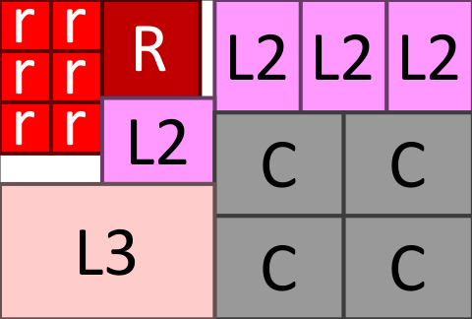
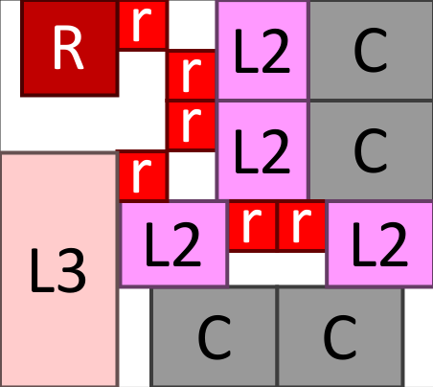
Minimizing wire length
C
C
R
L2
L2
r
r
r
r
r
r
L2
L2
C
C
L3

Slide 6
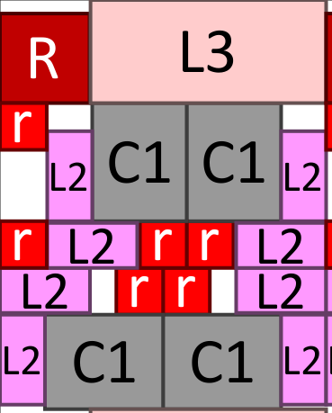
Maximizing regularity
Reusability
Design closure
Reduce floorplanning cost

Slide 7
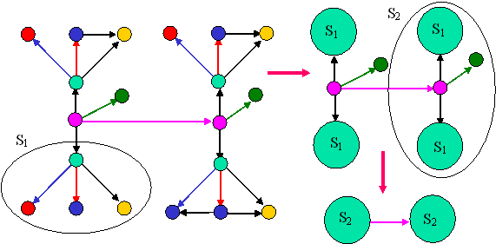
Finding repeating subgraphs
Frequent subgraph discovery:
Subdue: D. J. Cook and L. B. Holder, Graph-Based Data Mining, IEEE Intelligent Systems, 15(2), pages 32-41, 2000.

Slide 8
Example
Find candidate pattern
The most repeated subgraph
C
C
R
L2
L2
r
r
r
r
r
r
L2
L2
C
C
L3

Slide 9
Floorplanning a pattern
Find repeated pattern
Floorplan pattern
C
C
C
r
L2
C
C
r
L2
L2
r
L2
L2
L2
L2
r
r
Multiple floorplans are generated for a single pattern
C
All pareto-optimal floorplans efficiently stored as a bounding curve:
C
r
L2
C
L2
C
r
L2
r
L2
r
L2
L2

Slide 10
Creating hierarchy
Find candidate pattern
Floorplan pattern
Treat instances of pattern as black-boxes
C
C
R
C
L2
L2
P1
P1
P1
L2
r
r
r
P1
r
r
P1
r
r
L2
L2
P1 is a new component type
Has multiple shapes (defined by its bounding curve)
C
C
L3

Slide 11
Hierarchical floorplanning
Find candidate pattern
Floorplan pattern
Treat instances of pattern as black-boxes
Repeat until no more patterns can be found
R
C
P2
P1
P1
P1
r
L2
P2
P1
P1
r
r
L3
P2
P1
P1

Slide 12
Final floorplan
Floorplanning the last pattern obtains the bounding curve for the entire chip
L3
R
r
r
P2
R
P2
P2
R
P2
P2
r
r
r
r
L3
P2
P2
L3

Slide 13
Generating multiple results
P2
R
P1
P1
R
r
r
r
r
L3
L3
P2
P1
P1
C
C
R
C
C
R
L2
L2
R
r
L2
L2
r
r
L2
r
L2
r
r
r
L2
r
L2
r
r
C
C
r
r
L2
L2
L3
L2
L2
L3
L3
L2
L2
L2
L2
C
C
r
L2
r
L2
r
L2
r
L2
C
C
C
C
r
L2
L2
r
L2
L2

Slide 14
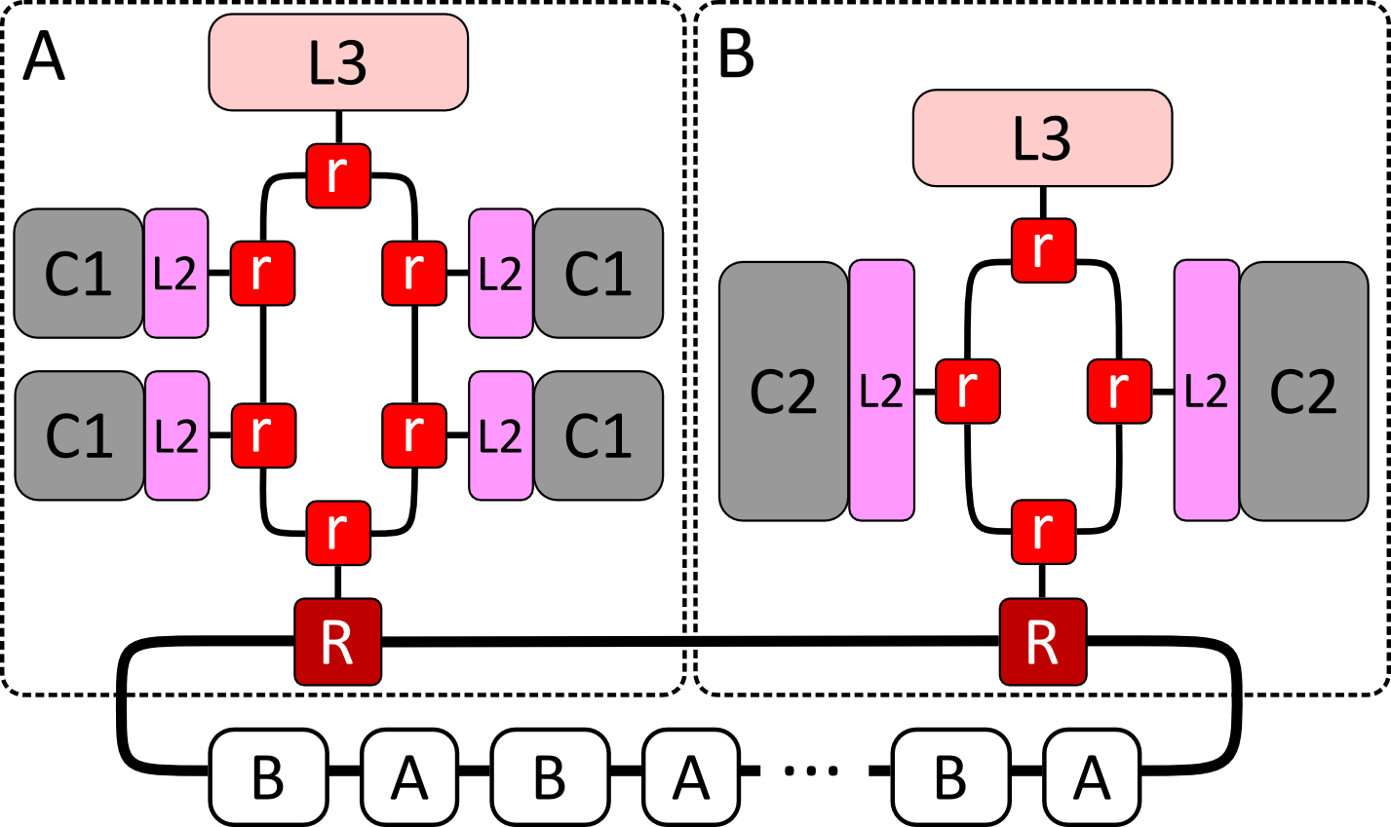
Example: ring of rings

Slide 15
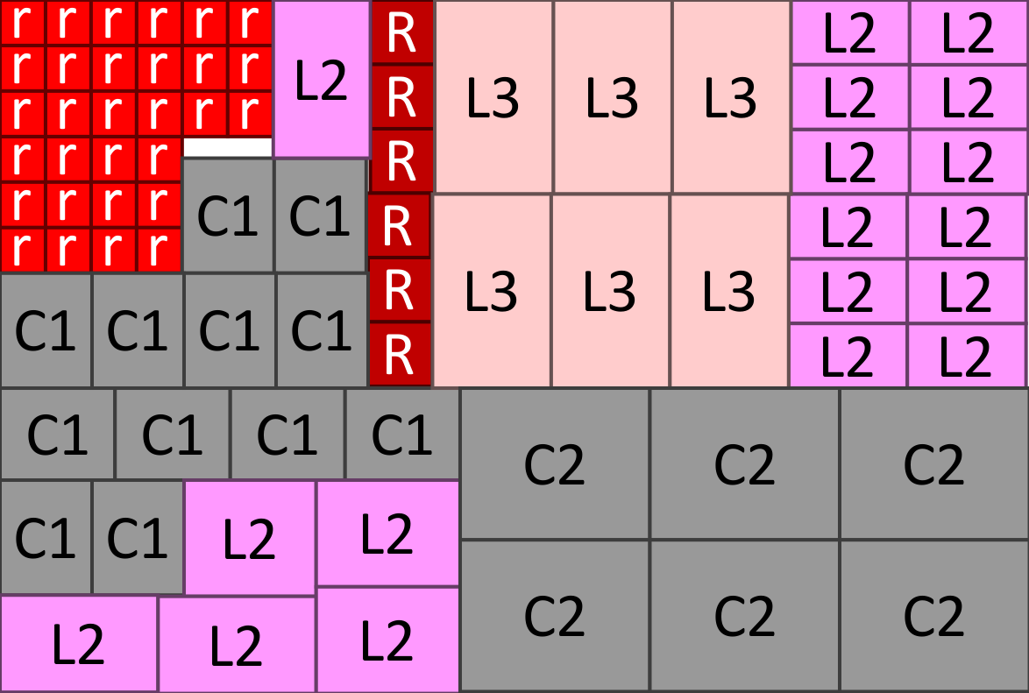
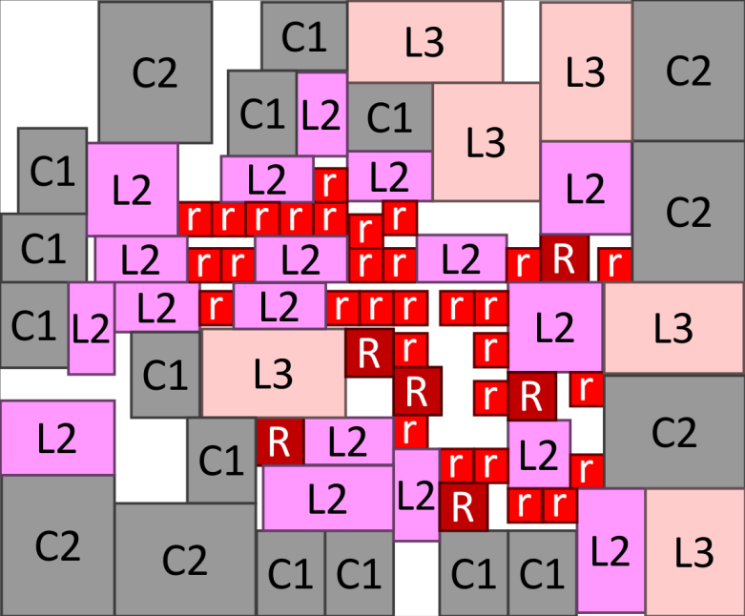
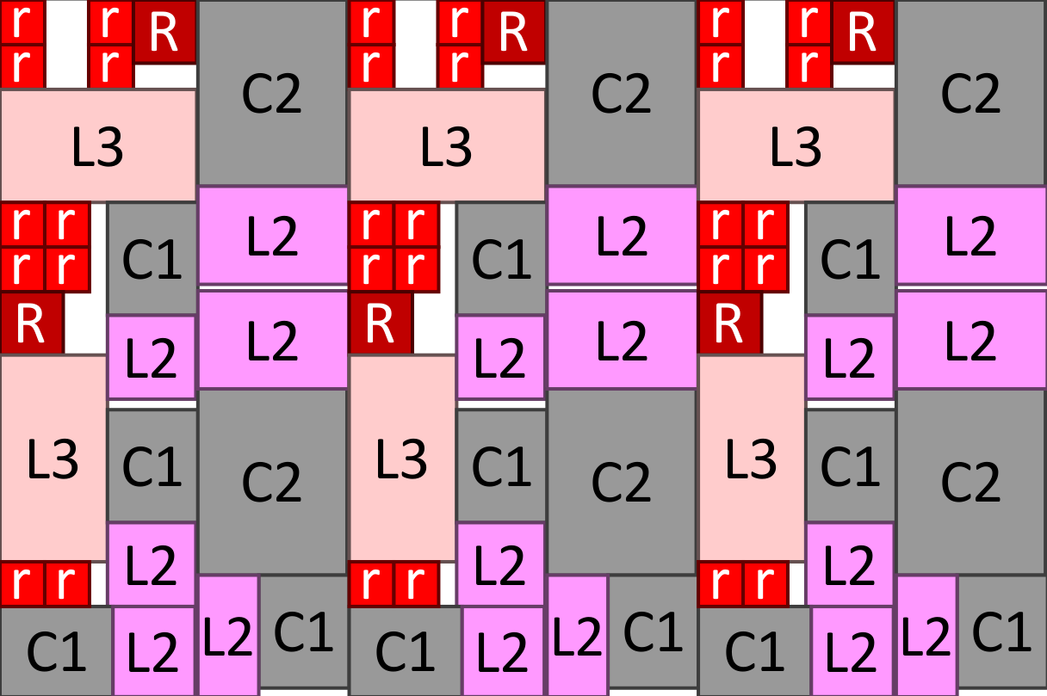
Example: ring of rings

Slide 16
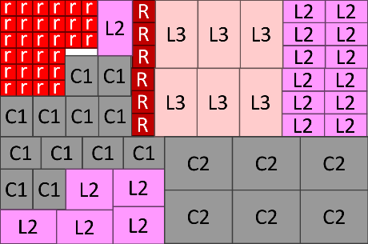
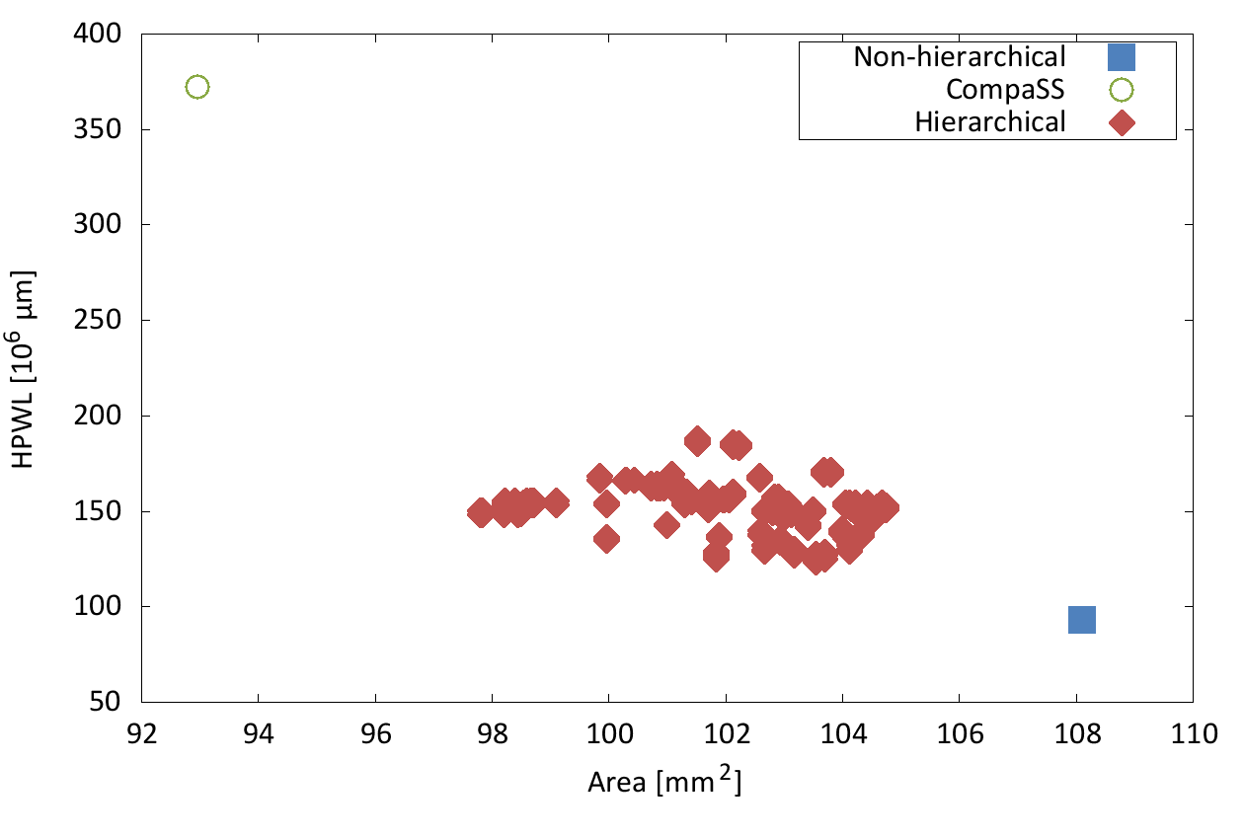
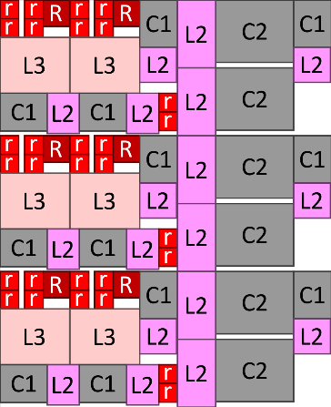
Estimated wirelength (meters)

Slide 17
Conclusions
We can extract regularity from a netlist and build regular floorplans
Competitive area, wire length results
Reduce design time
Future: application to other domains
High-level synthesis, logic synthesis, …

