Slide 1
Analysis and Optimization of Question Answering Systems
David Dominguez Sal
Director: Josep Lluis Larriba Pey

Slide 2

Analysis and optimization of question answering systems
Evolutive Summary Counters
Multi-layer cache
Cooperative caching
Cache-aware load balancing
Multi-layer cache analysis
Performance analysis
Single computer
Distributed System
Notes:
Title of this thesis Analysis….
It is about performance QA systems
We propose several techniques related
Divided into two parts

Slide 3
Analysis and optimization of question answering systems
(Chapter 3)
Evolutive Summary Counters
Multi-layer cache
Cooperative caching
Cache-aware load balancing
Multi-layer cache analysis
Performance analysis
D. Dominguez-Sal, M. Surdeanu. A Machine Learning Approach for Factoid Question Answering. SEPNL, 2006

Slide 4
Question Answering: What is it?
An automated tool that can search and retrieve information from a textual document repository.
Different from traditional IR keyword based search engines
Queries are expressed in natural language.
The answer is a precise answer to the stated question.
Example
What country is Aswan High Dam located in?
Egypt

Slide 5
Question Answering System
Sequential System of 3 blocks.
Question Processing
Analyizes the question asked by the user
Passage Ranking
Access to document collection to retrieve the most relevant documents for the answer.
Answer Extraction
System “reads” the passages, identifies the candidate answers and choses the best.
We implement a POS tagger and a name entity recognize.
QP
PR
AE

Slide 6
QA Evaluation
Our implementation is based on published research on QA.
Working factoid QA system
Person / Location / Organization
Representative and difficult data types
TREC query and data collections
Evaluation:
MRR: 1st position=1; 2nd position=0.5; 3rd position= 0.33…
Precision similar to state-of-the-art
0.37 entity, 0.52 long

Slide 7
Problem description (I)
Query computation is a slow process (initial system 0.05 q/s)
QP is not time consuming
~2% of total time.
PR and AE take most of the processing time:
PR: Accesses to disk (I/O). Retrieves raw documents.
AE: Natural language analysis of the documents (CPU). Generates processed documents.
QP
PR
AE

Slide 8
Problem description (II)
Document collection does not fit in memory but in disk.
The workload of a search engine follows skewed distributions.
Data is accessed more than once.
Solution: cache data in memory!
Documents are not updated very often.
We accept only the addition of new documents to the collection
NETWORK
QA
Server
QA
Server
Cache
Cache
…
Disk
Disk
Notes:
We are dealing with systems that access to big document collections
In computer science programs access to documents more than once. And as we are smart engineers so we add a cache to the system. For example a web search engine follows a zipf law
Example a QA system. Search engine similar to a web search engine like yahoo. But in this case it can deal with NLP. What is the capital of Uruguay? Montevideo
We know from similar systems that the user issue the queries following zipfian distribution. This means that some questions are asked much more than the others.
We want to reduce the processing time so we propose to add a cache to the system to reuse the documents and the passages processed. With this technique we reduce the execution time of the most expensive parts: PR and AE for similar questions. Moreover questions of a similar topic, even if they are not searching for the same piece of information may need to access to the same documents to get an answer.
One of the restriction of the problem is that the document collection can not completely loaded into memory. So we can not simply cache all the elements processed by the system.

Slide 9
Experimental environment
Evaluate TREC resources
TREC document collection (~1M docs)
We pick per/loc/org queries from TREC evaluations.
Query logs from IR search engines follow zipfian distributions
According to previous publications. We generate query logs following : Zipf_{α=0.59}, Zipf _{α=1.00}, and at most Zipf_{α=1.40}
Evaluation hardware
16 computers
1 client
Intel Dual core
2Gb RAM per computer

Slide 10
Analysis and optimization of question answering systems
Single computer
Evolutive Summary Counters
Multi-layer cache
(Chapter 4)
Cooperative caching
Cache-aware load balancing
Multi-layer cache analysis
(Chapter 5)
Performance analysis
D. Dominguez-Sal, J.L Larriba-Pey, M. Surdeanu. A multi-layer Collaborative Cache for Question Answering. Europar 2007

Slide 11
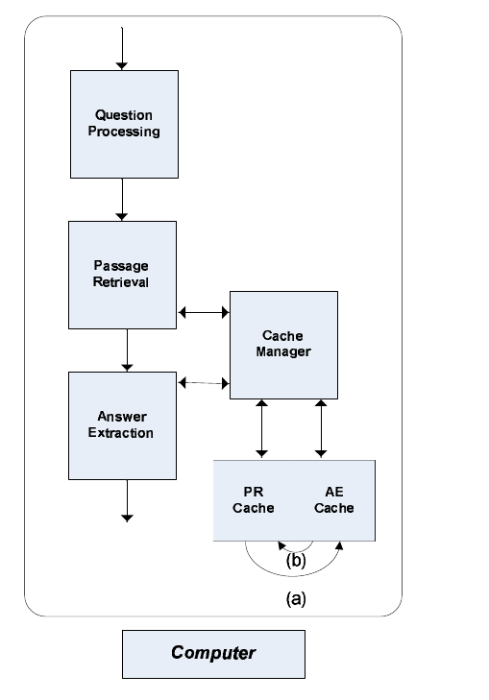
Multi-layer cache
Cache unit = document:
Natural language enables users to express the same query in many ways.
Queries on similar topics will read similar documents.
Divide the pool of memory in two inclusive sections (layers):
PR layer caches raw documents
AE layer caches raw documents + document analysis
Notes:
We have two expensive blocks in QA so we will try to cache both sections. Our objective is to take a pool of memory and use it to store things that are requested more than once.
The first demanding phase is PR. This phase retrieves the documents from the disk se we will store this documents in memory to save disk accesses.
The second phase is AE where we cache passages. We call a passage a document plus its document analysis. This means that our cache is inclusive if we have something stored in AE layer we have the information also to solve the request when PR block asks for it
We manage each layer with a LRU so the documents more used are more likely to be in cache.
We also provide two operations which we call promote and demote to move entries from one cache to other. The first time we ask for a passage we enter it into AE cache and move the oldest entry to PR.
Example

Slide 12
Multi-layer cache
Intra layer policy: LRU
Inter layer policy
(a) Promote: when is first requested for AE.
(b) Demote: oldest entry in AE section. This operation reset data.

Slide 13
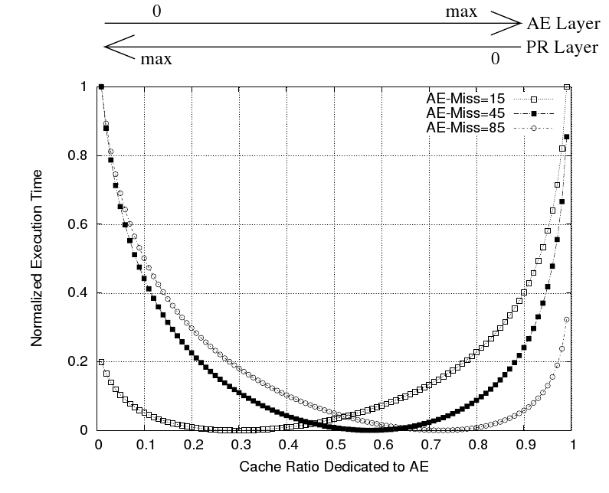
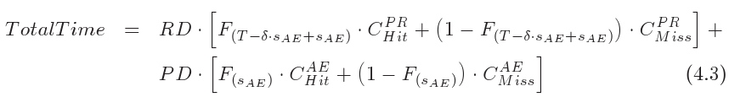
Analytical model
QA is an adequate candidate for multi-layer caches because of query distribution skewness
Cache partitioning is better than single caches

Slide 14
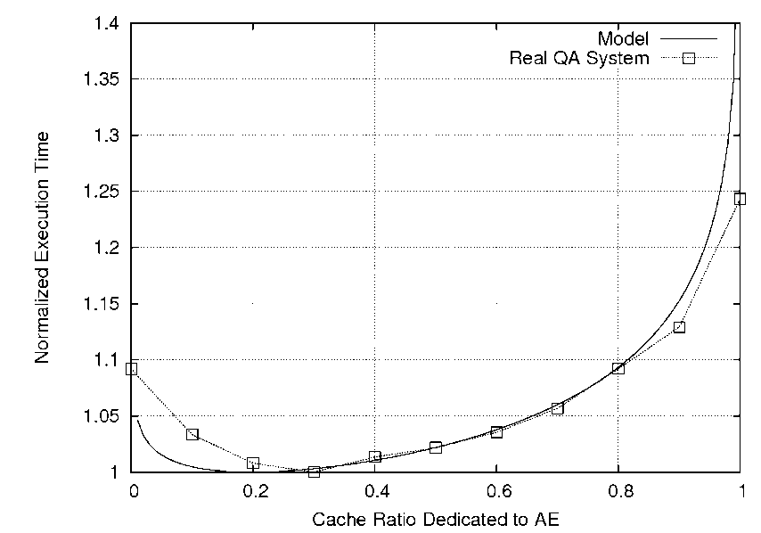
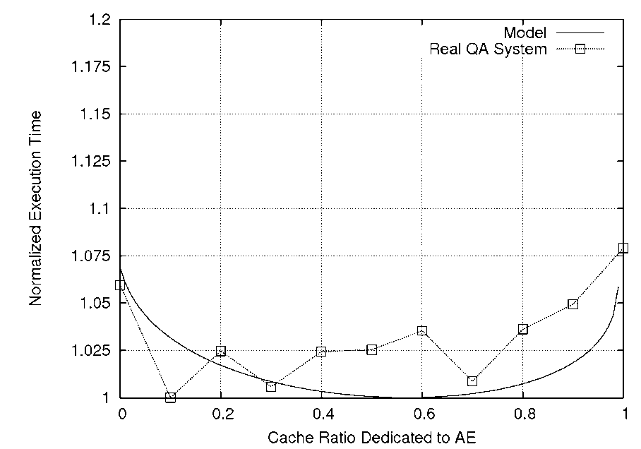
Multi-layer
Results with our QA system
Best performance happens with partitioning.
Good match experiments vs model
More details in chapter 4 of the thesis (statistical analysis of multi-layer caches)…

Slide 15
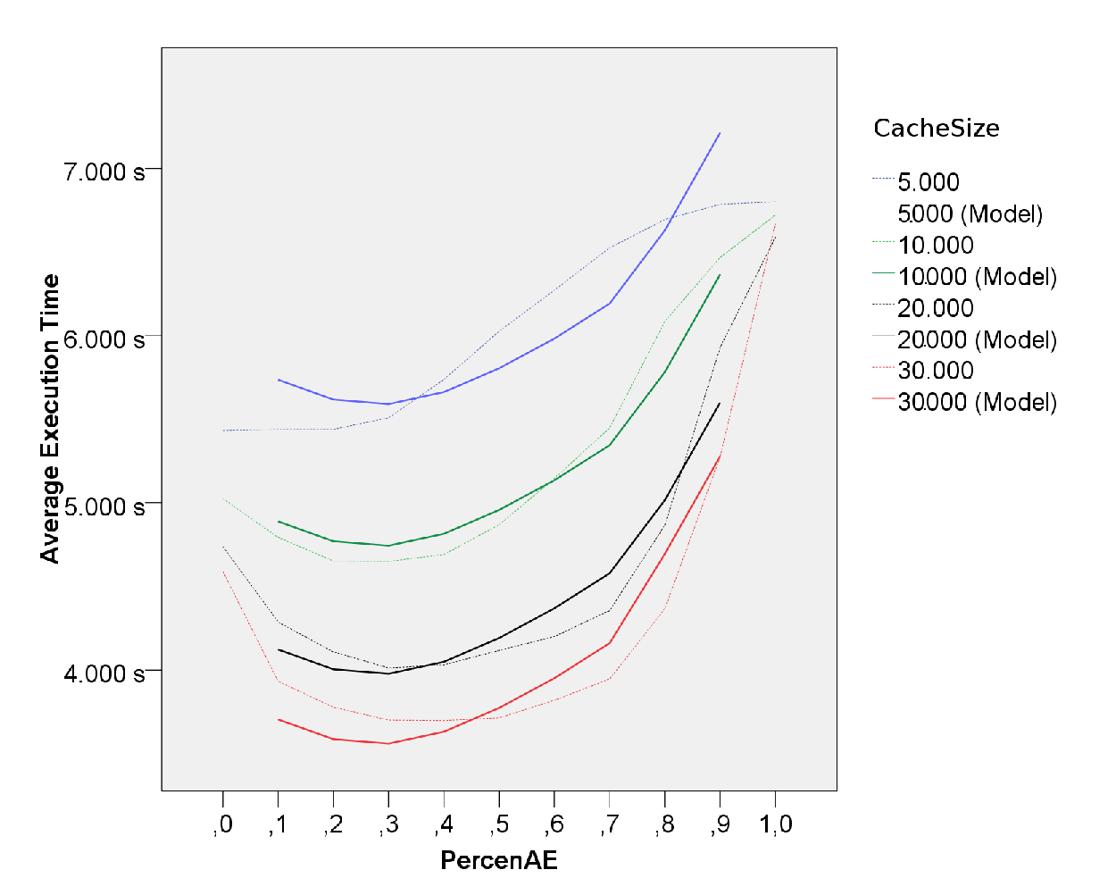
Experiments
Multi-layer are caches benefitial.
Easy configuration.
Effect more sever for larger caches
More detail in statistical analysis in chapter 4

Slide 16
Analysis and optimization of question answering systems
Distributed System
Evolutive Summary Counters
(Chapter 6)
Multi-layer cache
Cooperative caching
Cache-aware load balancing
Multi-layer cache analysis
Performance analysis
D. Dominguez-Sal, M. Surdeanu, J. Aguilar-Saborit, J. Larriba-Pey. Cooperative caching based on the recent data access history. Submitted to TPDS

Slide 17
Distributed search engine
Collections of replicas of the single computer system.
Centralized points are problematic
Node failures are not so rare.
Peer to peer architecture
Cooperative cache
LAN environment

Slide 18
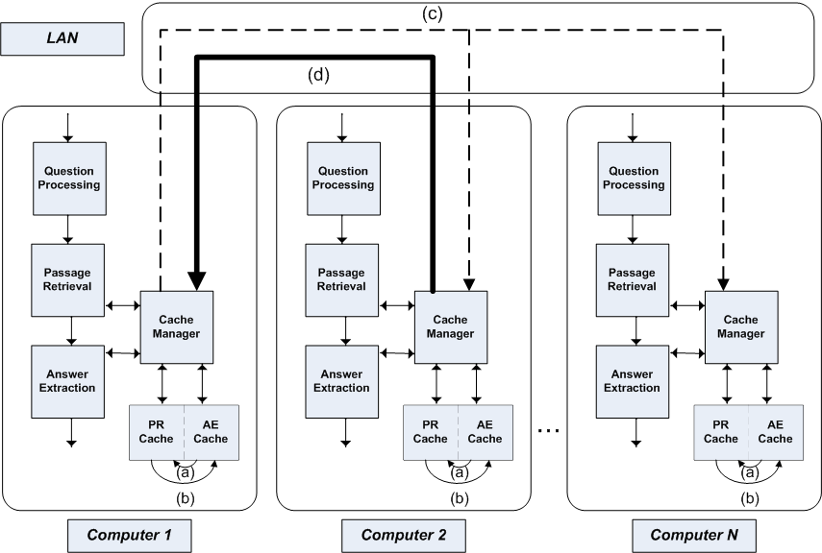
Distributed search engine

Slide 19
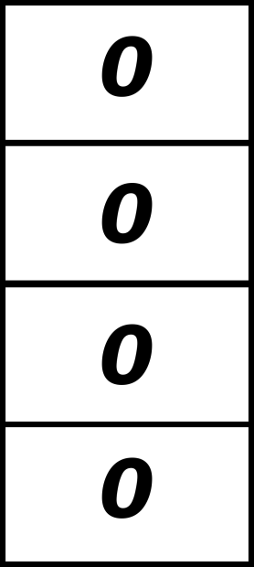
Monitor system state
We want a data structure that monitors the data access trends in the system.
Bloom filter
Often used to detect if an element belongs to a set with high probability
Multiple hashes on a bitmap

Slide 20
Monitor system state
We want a data structure that monitors the data access trends in the system.
Bloom filter
Often used to detect if an element belongs to a set with high probability
Multiple hashes on a bitmap
Read
Document 1

Slide 21
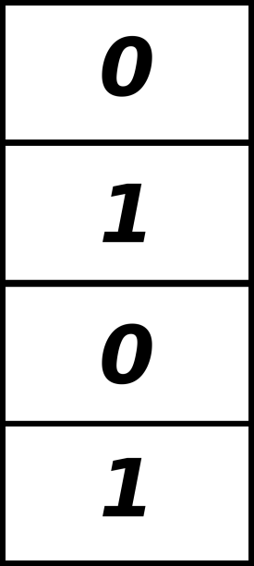
Monitor system state
We want a data structure that monitors the data access trends in the system.
Bloom filter
Often used to detect if an element belongs to a set with high probability
Multiple hashes on a bitmap
Read
Document 1

Slide 22


Monitor system state
We want a data structure that monitors the data access trends in the system.
Bloom filter
Often used to detect if an element belongs to a set with high probability
Multiple hashes on a bitmap
Was document 1 read?
Was document 3 read?

Slide 23
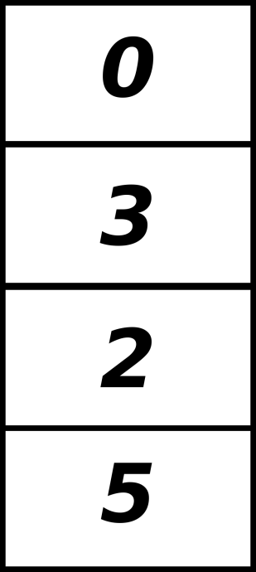
Count Bloom Filters
Count Bloom Filter is an extension in order to record frequency
Replace bitmap by a counter
How many document 1?
How many document 3?
3 times
0 times

Slide 24
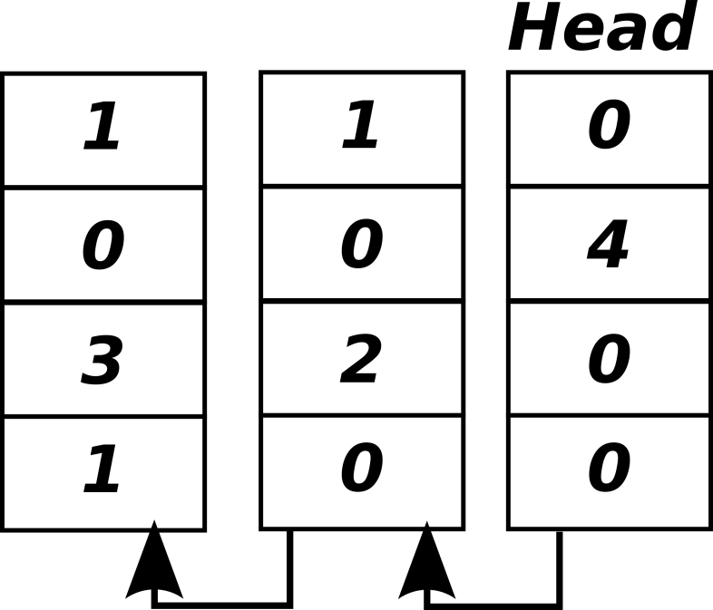
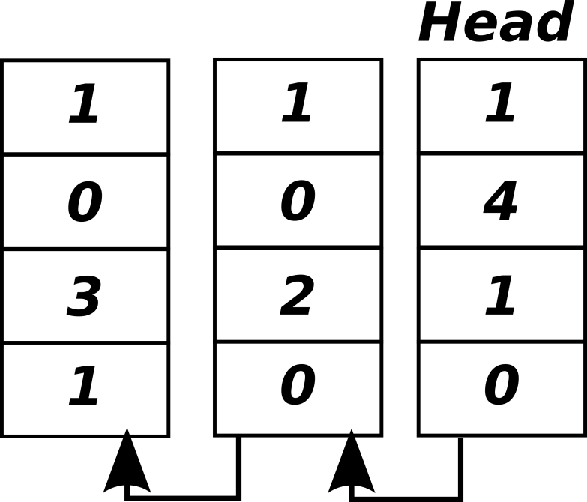
Evolutive Summary Counters
Monitor the evolution of the system
Use a list of Count Bloom Filters
Increment the counters of the head for each access
Read document 1

Slide 25
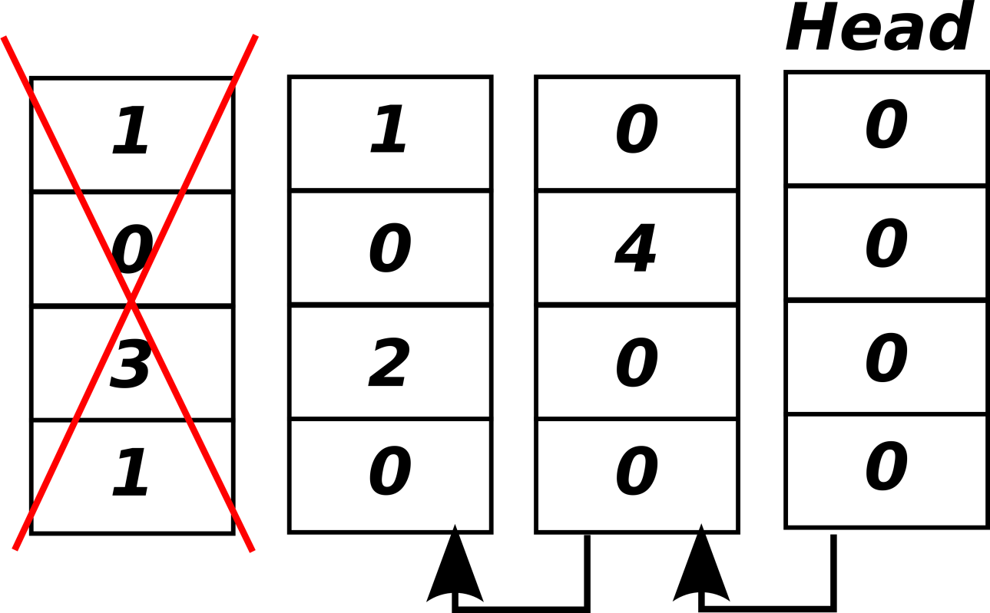
Evolutive Summary Counters
Periodically, summarize and slide
Slide
Update history
Set an empty CBF as the head of the list
Remove the oldest

Slide 26
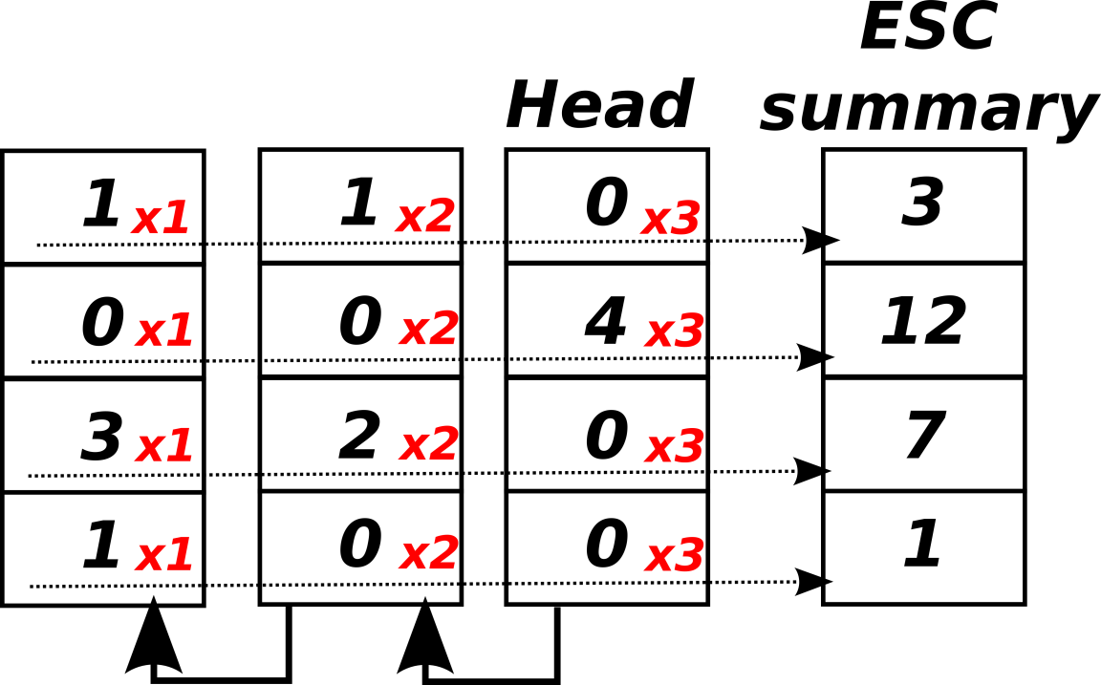
Evolutive Summary Counters
Periodically, summarize and slide
Summary
Send the summary to all neighbors
Linear summarization (weighted)

Slide 27
Analysis and optimization of question answering systems
Distributed System
Evolutive Summary Counters
Cooperative caching
(Chapter 7)
Cache-aware load balancing
Multi-layer cache
Multi-layer cache analysis
Performance analysis
D. Dominguez-Sal, M. Surdeanu, J. Aguilar-Saborit, J. Larriba-Pey. Cooperative caching based on the recent data access history. Submitted to TPDS

Slide 28
Placement
Placement:
In which node(s) should a document be cached? How many copies?
Objectives
Send data to where it is being used.
Keep at least a cached copy
Avoid too much copies not frequent documents.
Reduce forward chains.

Slide 29
ESC-placement algorithm
Use a regular cache policy to select the cache victim.
Forward the victim to the nodes whose value for the document in the ESC-summary is larger.
Encourage locality
Reduce copies
Likely to reduce chains (receiver is likely to have already the document cached)
Forwarding counter.
If exceeds a threshold discard the document.

Slide 30
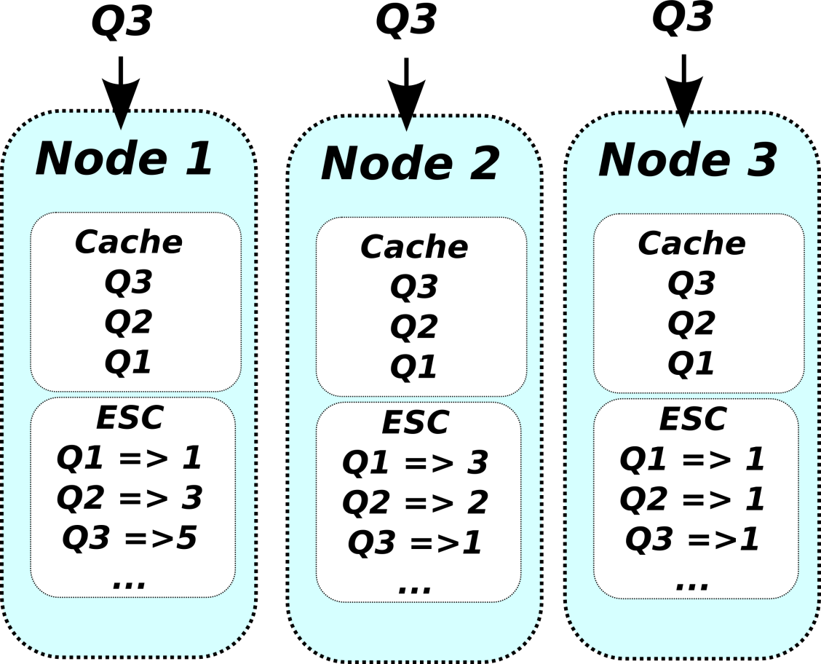
ESC-placement example
Keep several replicas if documents are accessed in many nodes

Slide 31
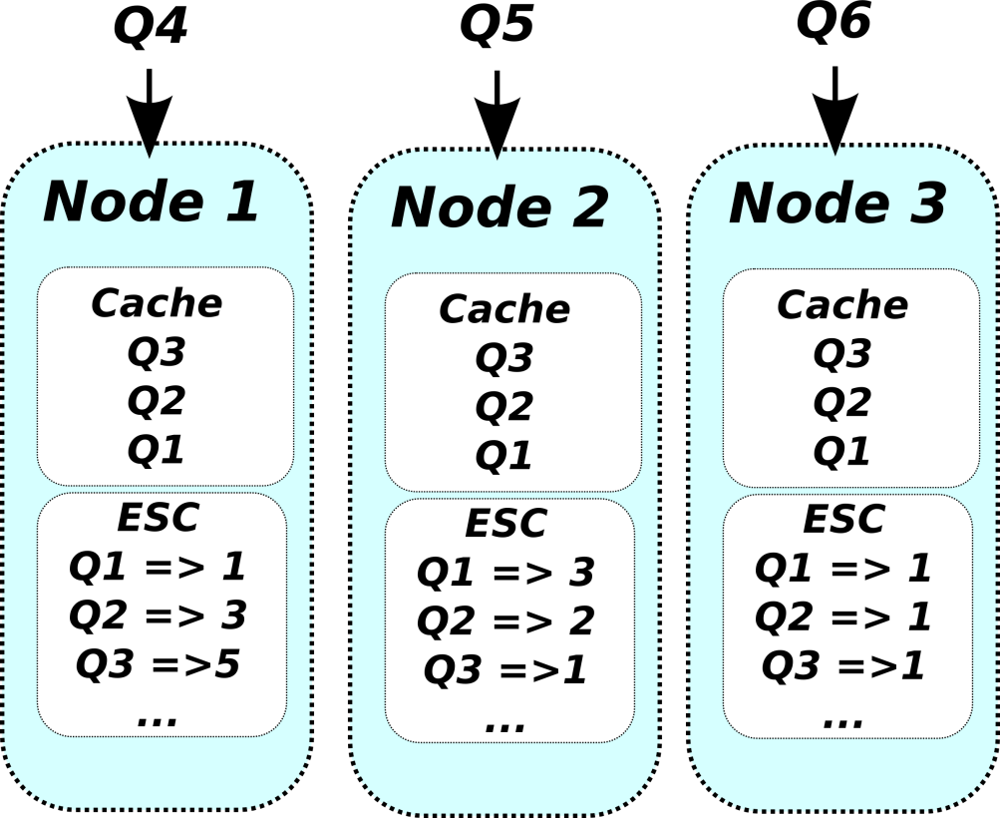
ESC-placement example
Keep several replicas if documents are accessed in many nodes
… and reduce the number if the workload diversifies.

Slide 32
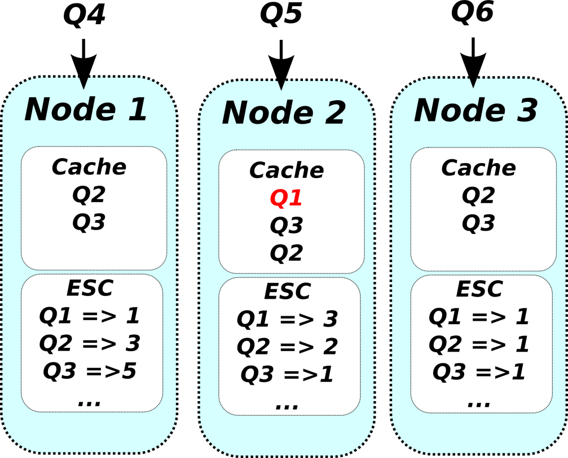
ESC-placement example
Keep several replicas if documents are accessed in many nodes
… and reduce the number if the workload diversifies.

Slide 33
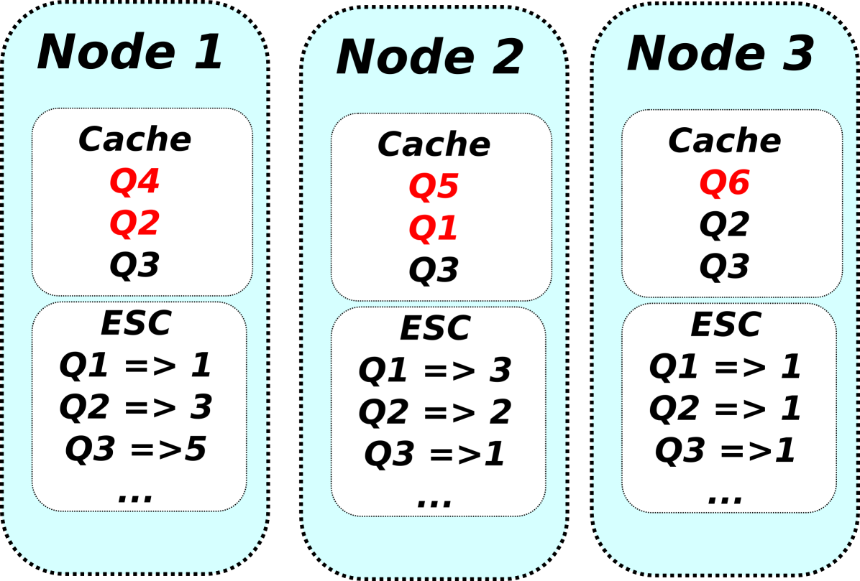
ESC-placement example
Keep several replicas if documents are accessed in many nodes
… and reduce the number if the workload diversifies.

Slide 34
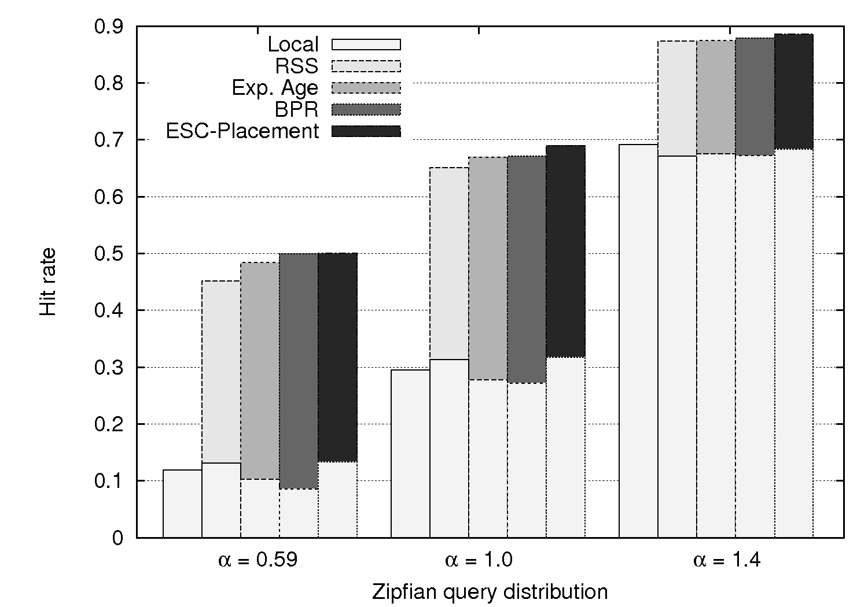
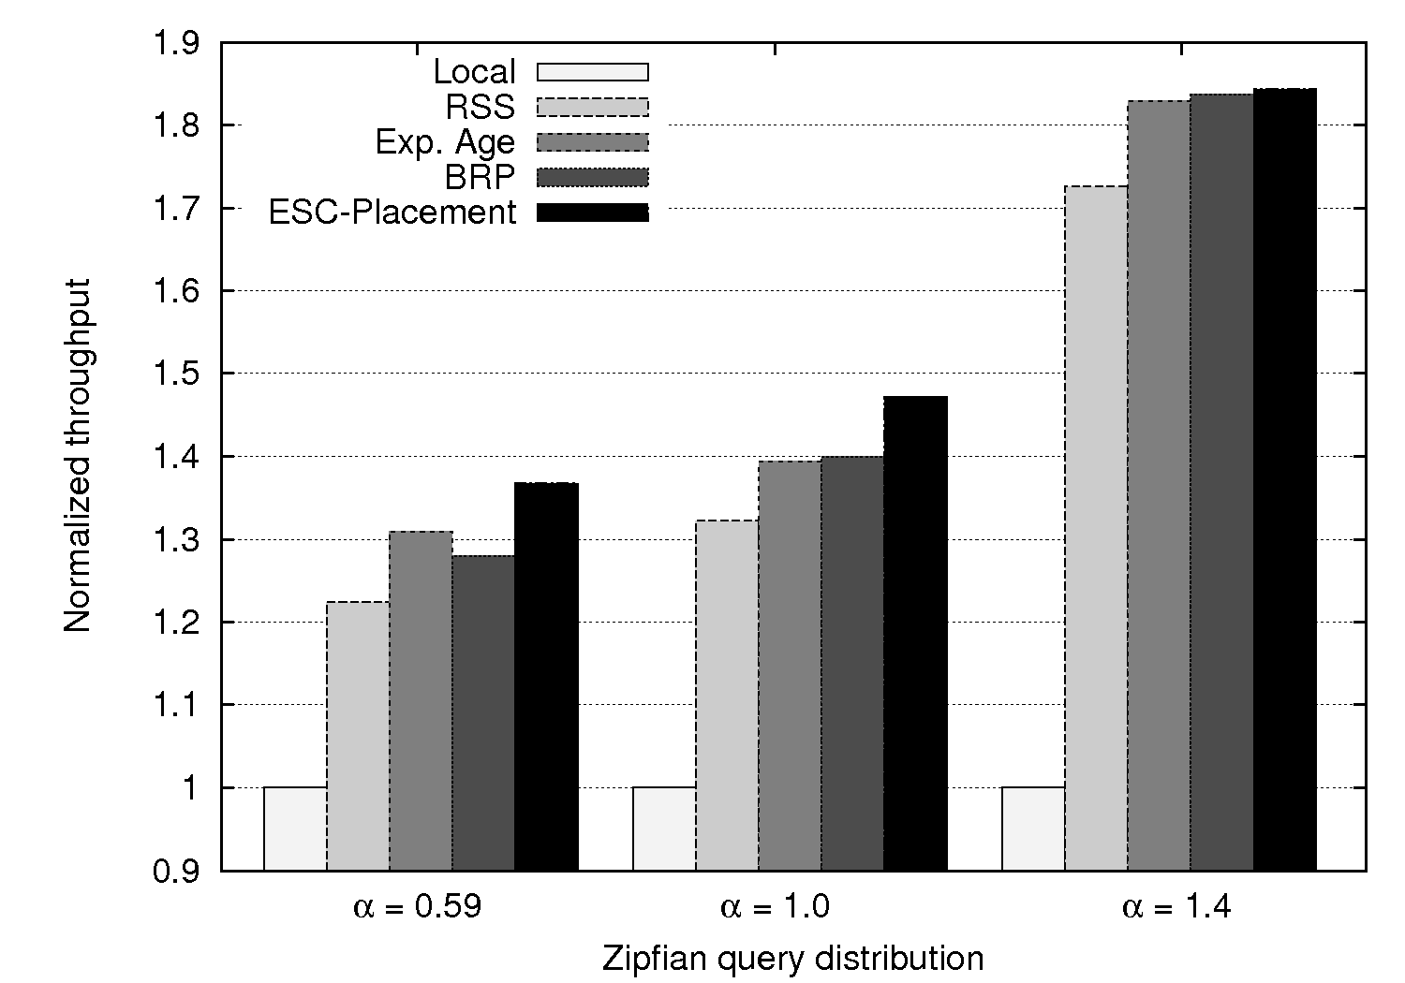
ESC-placement results
Hit rate
Throughput

Slide 35
ESC-placement results
Throughput
Local: No coop. cache
RSS: Random
Exp Age: Lowest contention
BPR: Repeted accesses

Slide 36
Data search
Locate a document in the cooperative cache
Decide how many nodes to query.
Objectives
Reduced number of nodes queried
Small avoidable miss
Adapt to workload
Notes:
Problema del broadcast
We want a fast search that the requests can be done in parallel to reduce latency

Slide 37

ESC-Search
Probabilistic map of the contents.
The more accessed the more likely to be in cache.
Estimator of presence based on frequency in ESC-summary
Update dynamically: prob_hit(freq=5) = 5/8
a) If hit: prob hit(freq=5) = 6/9
b) If miss: prob_hit(freq=5) = 5/9
Limit the probability of not finding a document
ESC-search does no network request
Unlike DHTs it is not necessary to chain requests to find data.
Notes:
El sistema calcula preguntando a 1 nodo la probabilidad de que

Slide 38
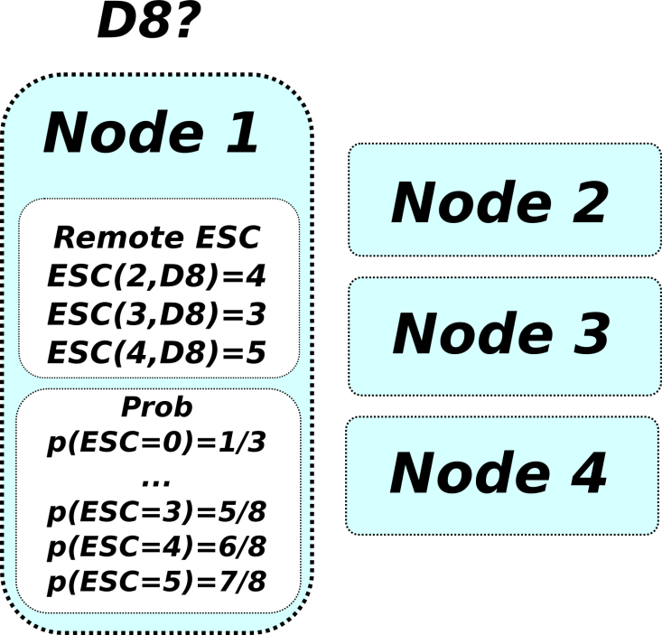
ESC-search example
Request node 4
Request node 4 and 2
Avoidable miss is set
to 0.10

Slide 39
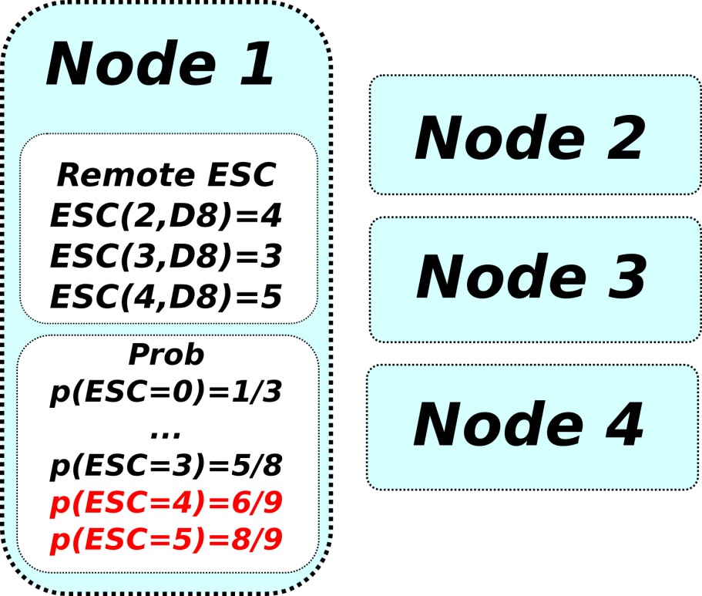
ESC-search example
Hit: N4 has document D8
p(ESC=5): 7/8 => 8/9
Miss: N2 did not.
p(ESC=4): 6/8 => 6/9

Slide 40

ESC-search example
ESC learns from experience and requests
Request node 4

Slide 41
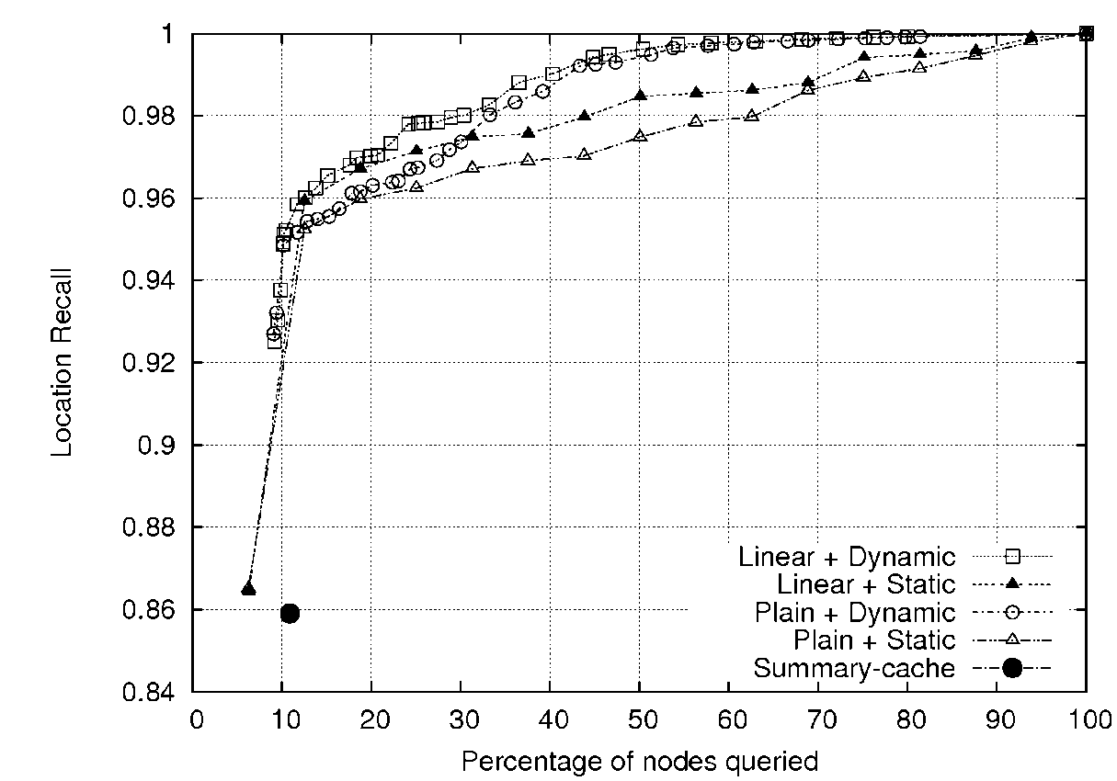
Experiments Search
Experiment with 16 nodes
Number of queries can be reduced to 1.5 nodes (10%)
ESC-placement better than summary caches
Frequencies provide additional information
Notes:
Broadcast equals to 100%

Slide 42
Analysis and optimization of question answering systems
Distributed System
Evolutive Summary Counters
Cooperative caching
Cache-aware load balancing
(Chapter 8)
Multi-layer cache
Multi-layer cache analysis
Performance analysis
D. Dominguez-Sal, M. Surdeanu, J. Aguilar-Saborit, J. Larriba-Pey. Cache-aware load balancing for question answering. CIKM 2008

Slide 43
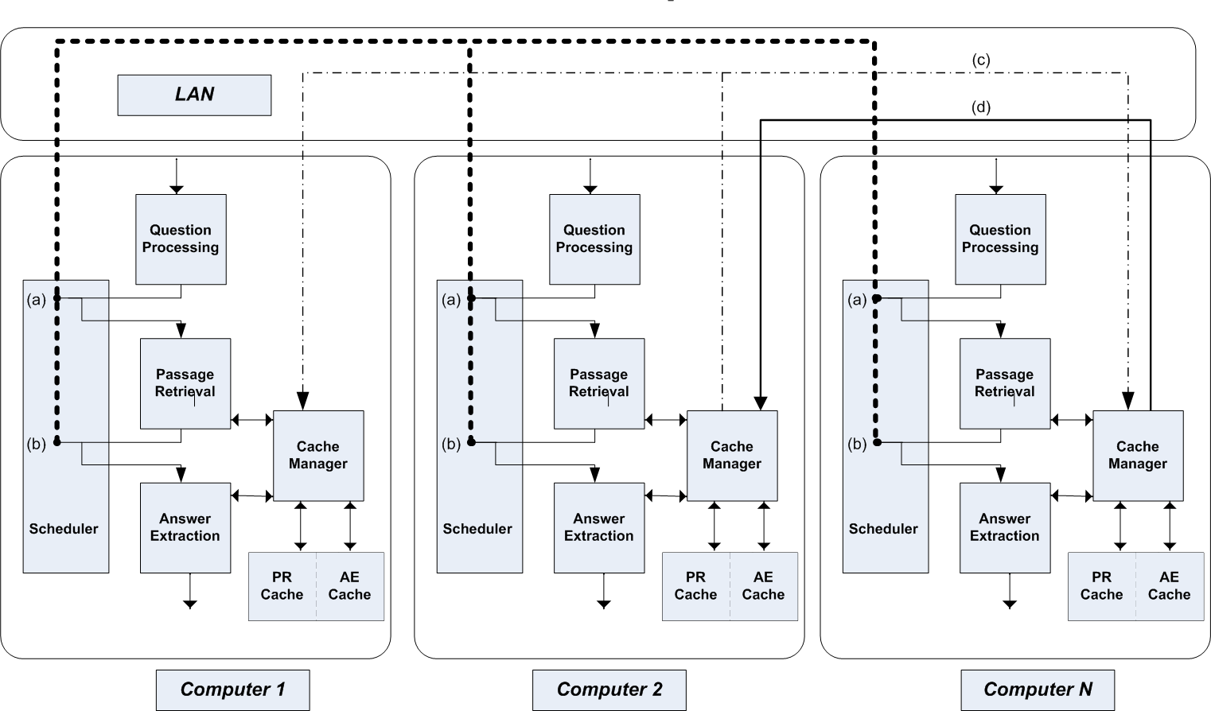
Distributed Search Engine Scheduler

Slide 44
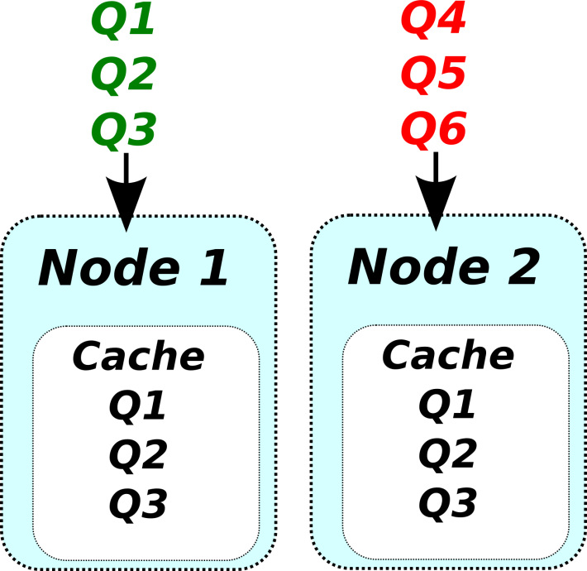
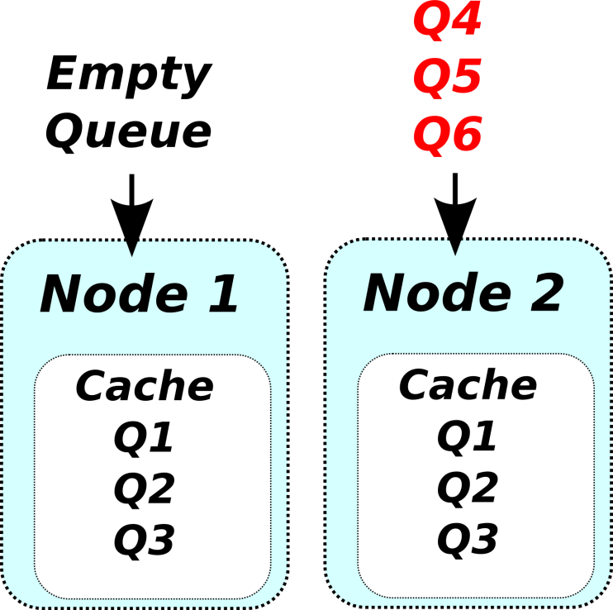
Load balancing
Objective
Distribute the workload to obtain the maximum performance of the available resources
Caches affect the execution cost of a query
Load balancer without cache considerations has incomplete information
Model shows with more cores, more computers and higher hit more unbalance.

Slide 45
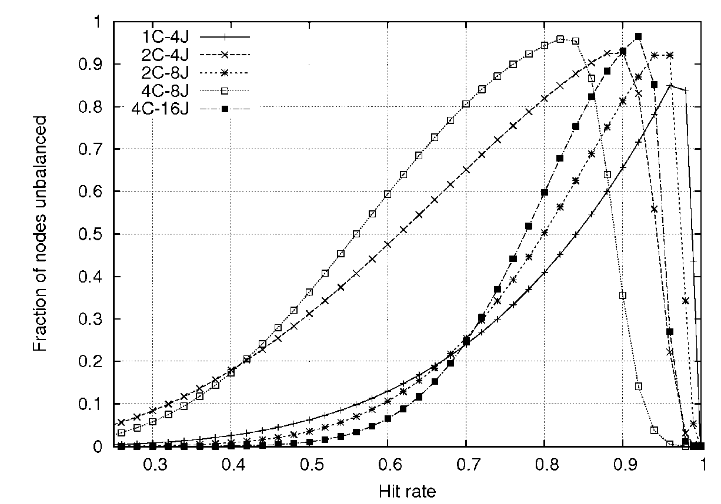

Load balancing and caches
Ideal load balancer based on costs
Results in unbalances
More cores do not make the balance easier either.
And more nothes neither!
Cache-aware techniques convenient
Notes:
In this paper, we discuss only performance issues of QA systems. We want to increase the throughput of Question Asnwering because they are very slow. Our initial system took about 20 (16) seconds to answer
We apply two techniques to have high performance QA: distribution and caching. Both of them are usual in large.
Caching reduces dramatically the execution time of the queries however it has a side effect for load balancing because it changes the cost to process a query. A query that may take a minute can be answered in one or two seconds. We show a model of this effect depending on the hit rate…

Slide 46
Baseline
QA requirements: CPU and I/O Aware
Weighted Average Load (Surdeanu et al.)
Estimators:
Cost of a query:
Load in a node:
Algorithm:
Estimate the CPU and I/O cost of the query.
Assign to the “least loaded server”:
But not cache-aware!

Slide 47
Load Balancing Proposal 1: Probability Cost
Estimate the cost considering cache contents:
The cost of a query depends on the node i.
The hit probability is estimated with the search algorithm
Cache-cpu-disk-aware
Notes:
In this paper we introduce two load balancing algorithms for Question Answering. The first one estimates the cost according to the cost to process a query in node. The formula we are using is the same

Slide 48
Load Balancing Proposal 2: Affinity
Improve hit rate
Convert remote hits into local hits.
Send the query to the node with similar cache contents
We calculate the affinity with Tf-Idf:
It difficults the replication of rare documents.
Note that tf-idf is not used to select the documents for the query!
Probability Cost
Notes:
In the second algorithm we want to improve the previous algorithm and we introduce the concept of similarity. Our objective is to send the query to the node that has more similar contents because then the query will hit a lot of contents in the local cache.
As a similarity measure we use TF-IDF. In terms of TF-IDF we model the query as the documents that will be accessed by the question, and each node is modelled as the vector of elements recently accessed, which is obtained from the ESC. The TF portion sends the query to the nodes where it is more probable to have a document. The nodes with higher TF tend to have a higher probability of caching a document.

Slide 49
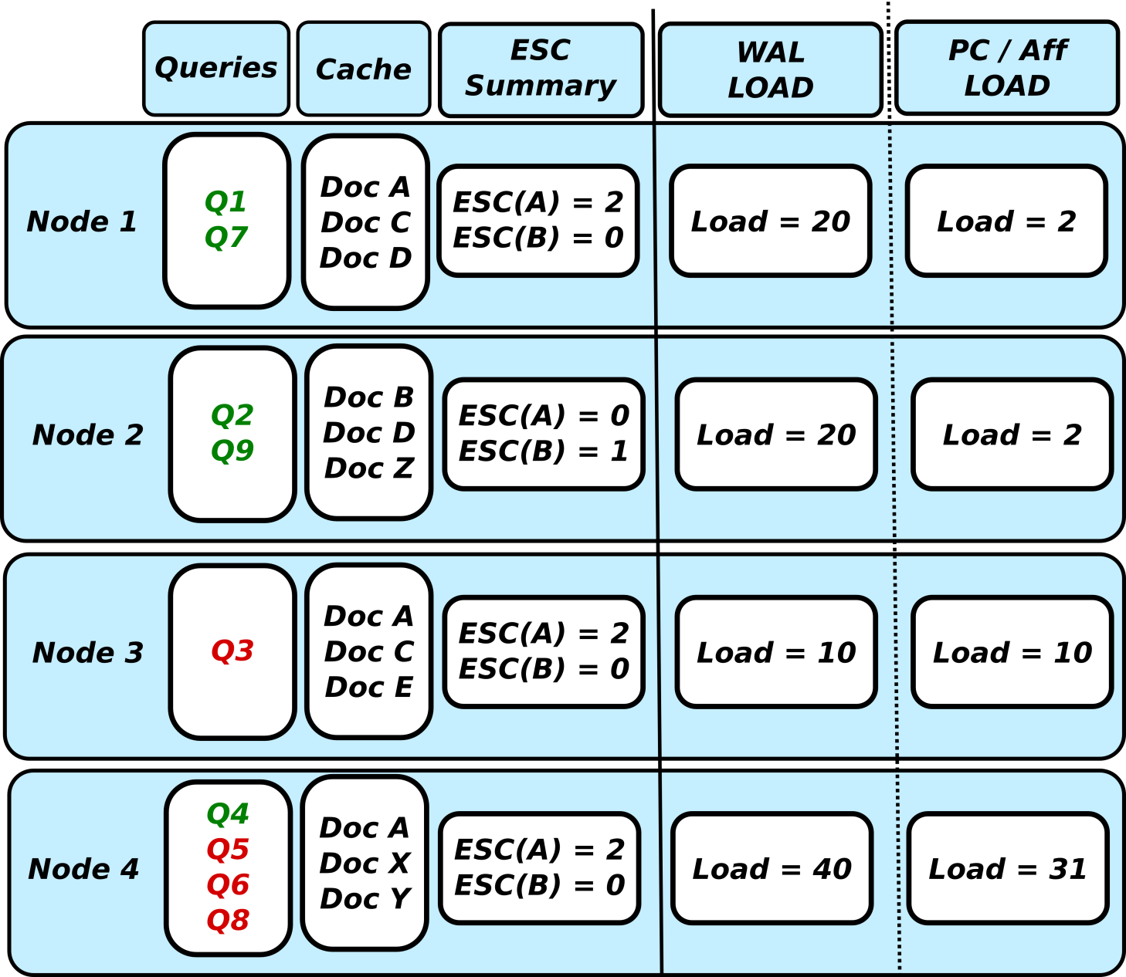
Comparison example
Q8 requests:
Doc A
Doc B
WAL
Prob. Cost
Affinity
Notes:
Forward Q8 Reads A and B

Slide 50
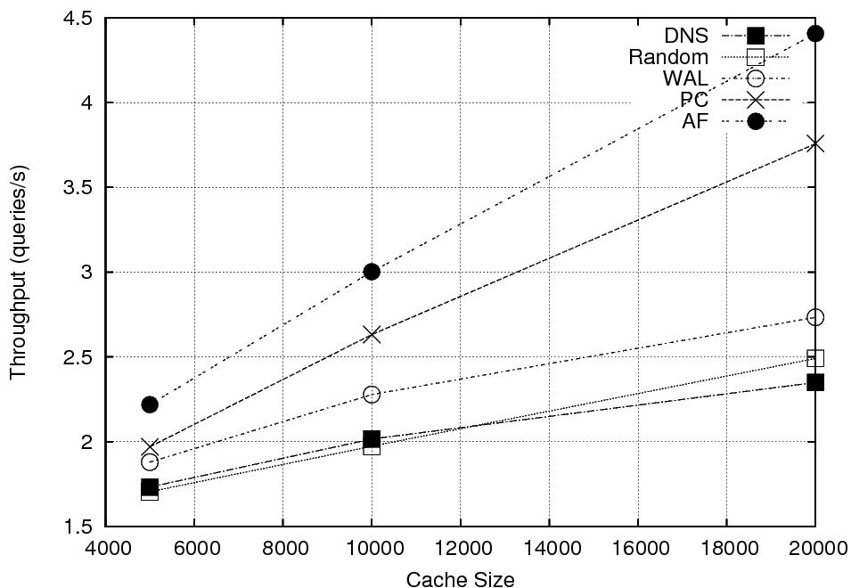
Experiments
Larger cache…
…more hits, more missprecitions by WAL…
…larger difference
Cache aware improve:
PC up to 37%
AF up to 61%

Slide 51
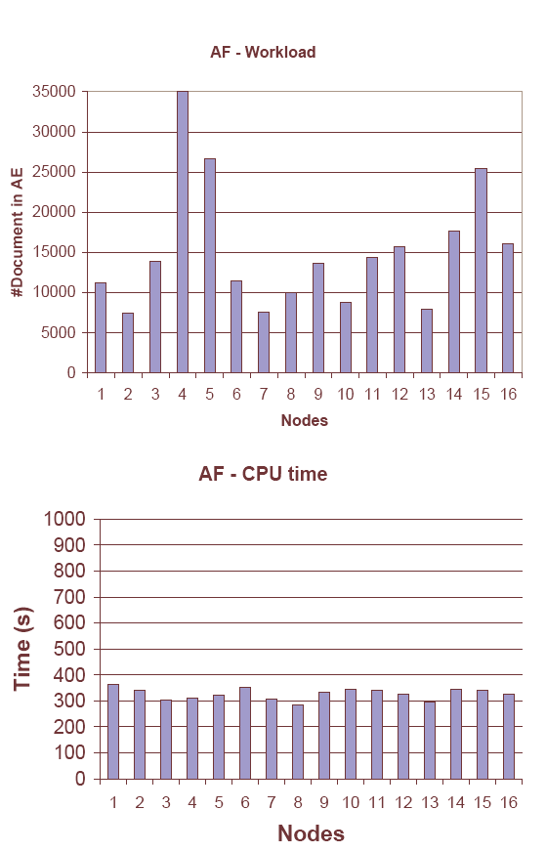
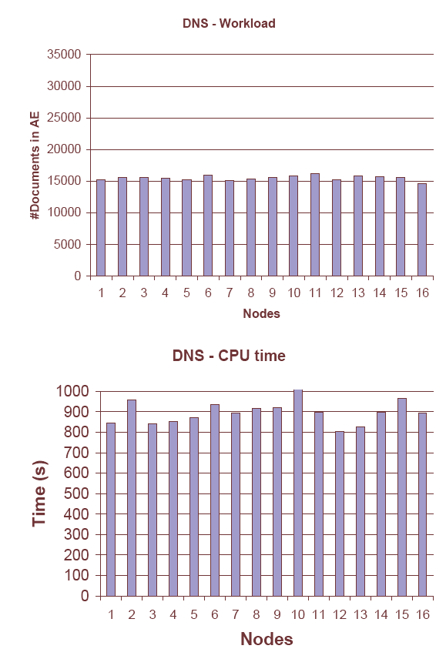
Workload Comparison
Balanced workload ≠ well balanced
Non Cache Aware
Cache Aware

Slide 52
Analysis and optimization of question answering systems
Evolutive Summary Counters
Cooperative caching
Cache-aware load balancing
Multi-layer cache
Performance analysis
(Chapter 9)
Multi-layer cache analysis
D. Dominguez-Sal, M. Perez-Casany, J. Larriba-Pey. Cache-aware load balancing vs. cooperative caching for distributed search engines. In HPCC 2009

Slide 53
Cooperative cache vs load balancing
Previoulsy, we improved the hit rate…
…moving cache contents (ESC-placement)
…moving queries incoming (Cache-aware load balancing)
Which policy is preferable?

Slide 54
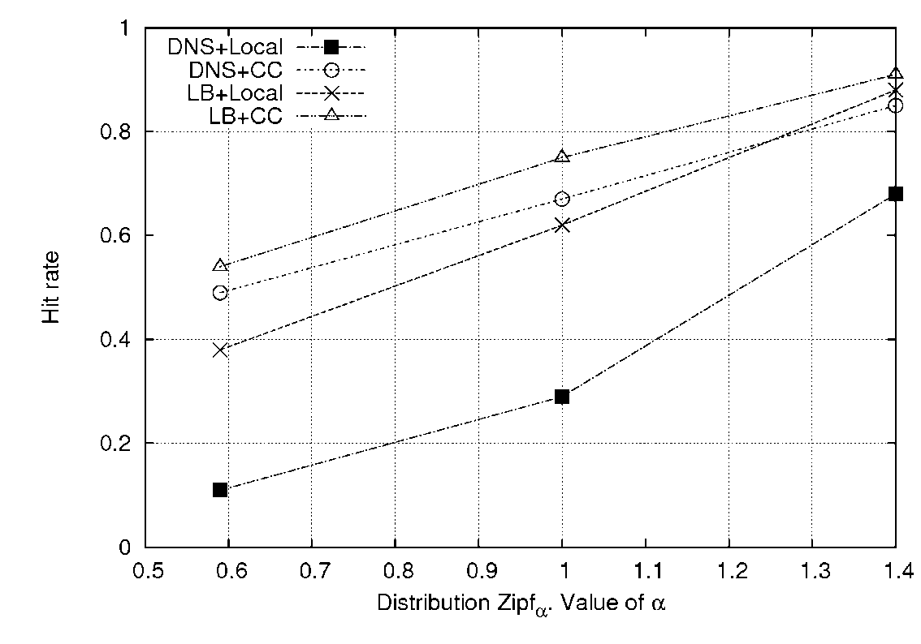
Cooperative cache vs load balancing
Individually, similar benefit hit rate.
Both activated? They interact but combination improves
Cooperative caching hits is more effective for scenarios with more preassure in caches.

Slide 55
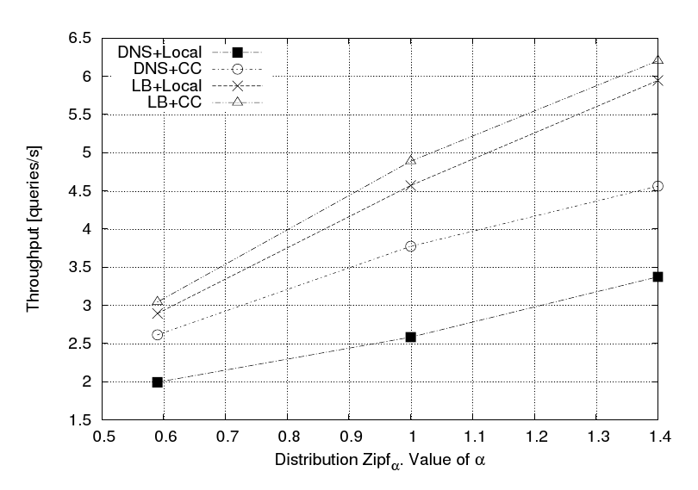
Cooperative cache vs load balancing
Moving queries is faster than forwarding documents.
Best throughput is obtained with both techniques enabled.
Large difference compared to local policies.

Slide 56
Conclusions
Single computer
Provide a modular implementation of a question answering system.
Multi-layer caches improve the performance of question answering systems
Statistical analysis about multi-layer caches
Distributed systems (I)
Evolutive Summary Counters efficiently summarize the data access trends in a distributed system.
ESC-placement improves the hit rate of a cooperative cache

Slide 57
Conclusions
Distributed Systems (II)
ESC-search locates documents in a distributed system with high recall
Cache-aware load balancing techniques achieve a more balanced real computation.
Combination of cooperative caching and cache aware improve create a sinergy and improve the system throughput
One order magnitude throughput improvement over the initial system.

Slide 58
Future work
Local cache replacement policies based on ESC
Exploit the evolution trend of the system
ESC scalability
Huge distributed systems / WAN
Reduce the number of ESC transmitted
More proposals in the thesis…

Slide 59
Papers
D. Dominguez-Sal, M. Surdeanu. A Machine Learning Approach for Factoid Question Answering. SEPNL, 2006
D. Dominguez-Sal, J.L. Larriba-Pey and M. Surdeanu: A Multi-layer Collaborative Cache for Question Answering. Euro-Par, 2007.
D. Dominguez-Sal, M. Surdeanu, J. Aguilar-Saborit, J.L. Larriba-Pey. Cache-aware load balancing for question answering. CIKM, 2008.
D. Dominguez-Sal, M. Perez-Casany, J.L. Larriba-Pey. Cache-aware load balancing vs cooperative caching for distributed search engines. HPCC, 2009.
D. Dominguez-Sal, M. Surdeanu, J. Aguilar-Saborit, J.L. Larriba-Pey. Cooperative caching based on the recent data access history. Submitted to TPDS.
Other publications
M. Surdeanu, D. Dominguez-Sal, and P. Comas. Design and Performance analysis of a Factoid Question answering System for Spontaneous Speech Transcriptions. Interspeech. 2006
D.Ferres, S.Kanaan, D.Dominguez-Sal, E.Gonzalez, A. Ageno, M. Fuentes, H. Rodrguez, M. Surdeanu, J. Turmo. TALP-UPC at TREC 2005: Experiments Using a Voting Scheme Among Three Heterogeneous QA Systems. TREC, 2005.

Slide 60

Thanks!
Questions

